Slide 1
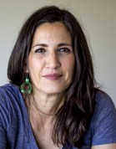
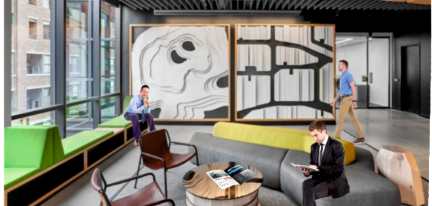
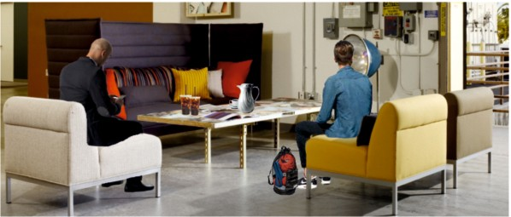
REVISION CARDS - VERDA ALEXANDER
WORLD ASSOCIATION OF TECHNOLOGY TEACHERS https://www.facebook.com/groups/254963448192823/
www.technologystudent.com © 2023 V.Ryan © 2023
VERDA ALEXANDER
Verda Alexander was born in Nicaragua and moved to the USA to develop her career. She graduated with a Bachelors Degree in Fine Art and a Masters in Landscape Architecture.
She is the Co-founder of an international interior design company called, ‘Studio O+A’ (co-founder Primo Orpilla), in San Francisco. Studio O+A have designed ground breaking oﬃce interiors for major companies. Studio O+A received the International Interior Design Association’s 2010 Northern California Award, for their work on Facebook’s headquarters in California.
Verda’s approach to design and research, involves consideration of social and environmental issues. These include climate activism, the environment, social justice and art. She believes in putting people and the planet at the forefront of design philosophy. Careful thought and research is put into selecting sustainable materials and reducing the carbon footprint of designs. Her designs strive to minimise the use of materials and to ensure that they have been ‘produced’, with ethical and fair treatment of the workforce.
She engages with the public and seeks their opinions, in a novel way. This is through a mobile oﬃce (a converted food truck) called, ‘Food for Thought Truck’.
OFFICE DESIGNS BY VERDA ALEXANDER
USEFUL LINK SCAN HERE
USEFUL LINK CLICK HERE
Link
1. Describe Verda’s early background in design?
2 marks
2. What is Verda’s approach to design and research?
3 marks
3. What is the ‘Food for Thought Truck’?
2 marks

