Slide 1
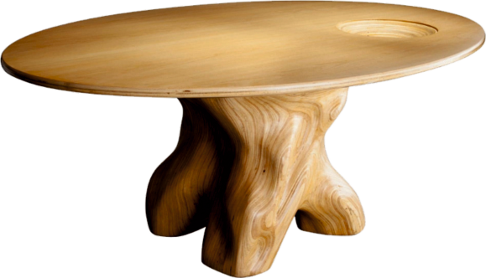
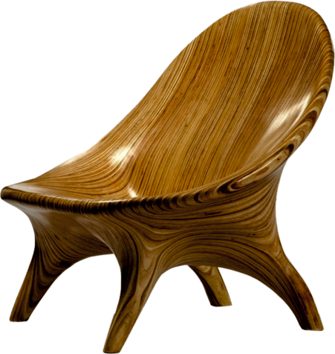
JULIA KRANTZ (BRAZIL) - REVISION CARDS
WORLD ASSOCIATION OF TECHNOLOGY TEACHERS https://www.facebook.com/groups/254963448192823/
www.technologystudent.com © 2023 V.Ryan © 2023
JULIA KRANTZ
Julia works with sustainable laminated natural wood, from Brazil.
Her work is both artistic, ecological and quite amazing.
She combines laminates of natural wood and skilfully forms them into furniture. Her work is not only stunning, but also technically demanding. Her furniture is hand made. Each piece of furniture has been carefully designed and has real meaning.
She aims through her sculptural work, to make a connection with the environment from which the wood was sourced. E.G., the way the wood grain falls and is enhanced by her carving, reﬂecting the rain and rivers of Brazil.
The Mesa Baum Table has a beautifully carved ‘trunk’ as a base and an elegant plywood table top. Looking carefully at the top, you will see a carved bowl in its surface. This is a reminder of a Krantz family story from the Second World War, when her grandfather carved a bowl shape into the family table, as they did have not enough to eat from, due to shortages.
Julia Krantz uses wood responsibly, relying on sustainable suppliers. Her work is made from stack-laminated plywood, approved by the Forest Stewardship Council. The stack laminated process is superior to more common production methods. Individual thin layers of natural wood are glued and compressed forming large blocks, ready for carving and routing.
MESA BAUM TABLE
'POLTRONA SUAVE' LOUNGE CHAIR
USEFUL LINK SCAN HERE
USEFUL LINK CLICK HERE
Link
1. Describe the style of work carried out by Julia Krantz ? 4 marks
1. How does Julia ensure that she uses wood responsibly ?
2 marks
3. Name and describe one of Julia’s furniture designs.
3 marks

