Slide 1
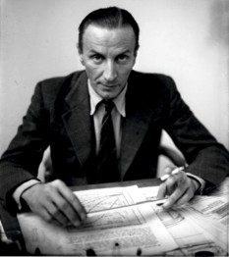
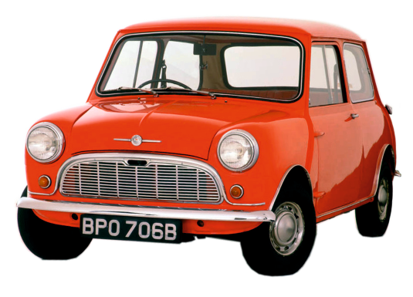
ALEXANDER ARNOLD CONSTANTINE ISSIGONIS - THE AUSTIN MINI - AN ICONIC DESIGN
WORLD ASSOCIATION OF TECHNOLOGY TEACHERS https://www.facebook.com/groups/254963448192823/
www.technologystudent.com © 2023 V.Ryan © 2023
ALEXANDER ARNOLD CONSTANTINE ISSIGONIS
The Austin Mini ﬁrst rolled oﬀ the production line in 1959 and was the brain child of Alexander Arnold Constantine Issigonis.
It was manufactured by the British Motor Company and was developed as a result of the shortage of petrol during and after the Suez crisis of the 1950s. It had a production run of 5.3 million cars and was the best selling British car, between 1959 to 2000. During the 1960s, it became popular with celebrities and was seen in ﬁlms and on TV across the world, ensuring that it became a design icon.
The Mini was at the forefront of design and engineering innovation. It was the ﬁrst small car to have front wheel drive and had small 10 inch wheels. It had a traverse engine, which saved space and allowed a reasonable sized engine to ﬁt into a small engine cavity. The sump was designed so that the same engine oil also lubricated the gears system. The radiator was on the left side of the engine cavity, again saving space. It had a suspension system, based on rubber cones, not conventional springs. This saved further space, allowing the car to be lower down than other similar cars of its day. Sliding windows were a feature, developed with this small car in mind. This innovative design also included storage space, in the doors.
One of its most famous appearances, was in the ﬁlm ‘The Italian Job’, driven by famous actors including Michael Cane.
USEFUL LINK SCAN HERE
USEFUL LINK CLICK HERE
Link
1. When did the ﬁrst Austin Mini role of the production line?
1 marks
2. Why was th Austin Mini considered innovative?
5 marks
3. It appeared in a famous ﬁlm with a very famous actor. Name the ﬁlm and actor.
2 marks

