Slide 1
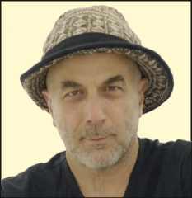
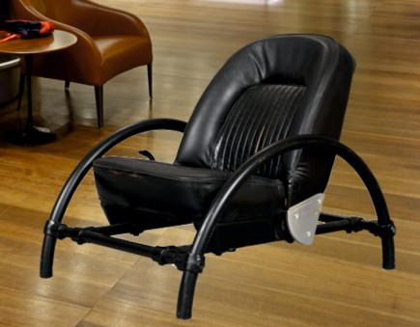
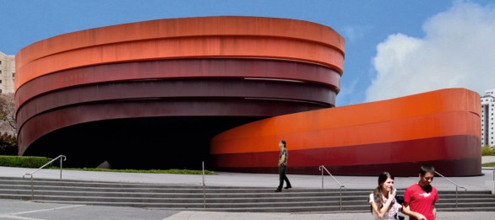
REVISION CARDS - RON ARAD
WORLD ASSOCIATION OF TECHNOLOGY TEACHERS https://www.facebook.com/groups/254963448192823/
www.technologystudent.com © 2023 V.Ryan © 2023
RON ARAD
Born in Israel in 1951. Studied Art, Design and Architecture in Jerusalem and London, in the 1970s. Formed Ron Arad Associates in 1989, specialising in product design and architecture.
In 2008 he established Rod Arad Architects. Ron Arad was the Head of the Design Products Department, at the Royal College of Art, between the years 1997 to 2009. His style is often a mix of technology, experimentation and ‘fun’. He has collaborated with many of the best known furniture makers and design companies, including Alessi.
THE ROVER CHAIR
Ron Arad’s early acclaimed work began in 1981 with the Rover Chair. The basic car seat was salvaged from a Rover 2000, in a scrap yard and updated with a metal tubular frame.
The basic car seat was salvaged from a Rover 2000, in a scrap yard and updated with a metal tubular frame.
ARCHITECTURE
Ron Arad has designed buildings around the world. The Nobu Hotel and the Holon Design Museum are just two examples of his innovative style.
The Holon Design Museum
Dedicated to ‘design’. Its design is based on an interlocking combination of curves and rectangles. A concrete structure, clad in ﬁve rings of weathered steel, carefully coloured to achieve the right tones.
USEFUL LINK SCAN HERE
USEFUL LINK CLICK HERE
Link
1. Where was Ron Arad born and where did he train as a Designer and Architect?
2 marks
2. Describe Ron Arad’s style of design? Which companies has he collaborated with? 4 marks
3. Name and describe one of his well-known designs.
4 marks

