Slide 1
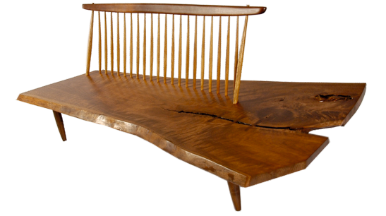
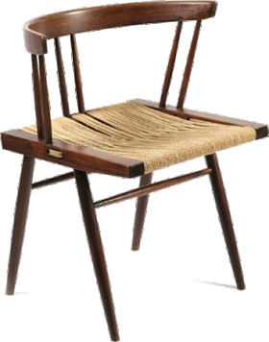
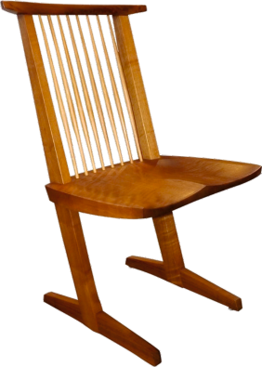
GEORGE NAKASHIMA - DESIGNER, WOODWORKER AND ARCHITECT
WORLD ASSOCIATION OF TECHNOLOGY TEACHERS https://www.facebook.com/groups/254963448192823/
www.technologystudent.com © 2023 V.Ryan © 2023
GEORGE NAKASHIMA
George Nakashima (1905-1990), said when he was designing furniture, he was having a ‘dialogue with a tree’.
He preferred to be called a ‘woodworker’ rather than a ‘designer’ and set high standards, not only in furniture design, but also in his mastery of techniques used in their manufacture. George was from a Japanese family and studied Architecture at the University of Washington. As a Japanese-American, he is acknowledged as one of the founders of the American Studio Craft movement. His work has been praised by fellow designers and is studied by students around the world.
His early career was in architecture, including working for a company, helping Frank Lloyd Wright in the design of the Imperial Hotel in Tokyo.
His interest in traditional Japanese furniture began to develop, whilst working in Japan.
He developed his high level crafts skills whilst imprisoned in an Internment Camp, in the USA, during the Second World War. He was taught by Gentaro Hikogawa, a Japanese carpenter, mastering traditional skills and the use of Japanese tools.
After the war he continued designing and making furniture in his signature Japanese style. Walnut was his favoured timber, often using one large piece as the top / main surface. His work reﬂects Japanese values of balance, harmony, and simplicity.
Conoid Bench
USEFUL LINK SCAN HERE
USEFUL LINK CLICK HERE
Link
Grass Seated Chair
Conoid Chair
1. What did George Nakashima say when he was designing?
1 mark
1. Name three pieces of furnituture by George Nakashima.
3 marks
3. Brieﬂy, describe George Nakashima’s career?
5 marks

