Slide 1
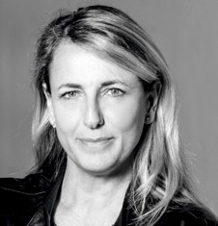
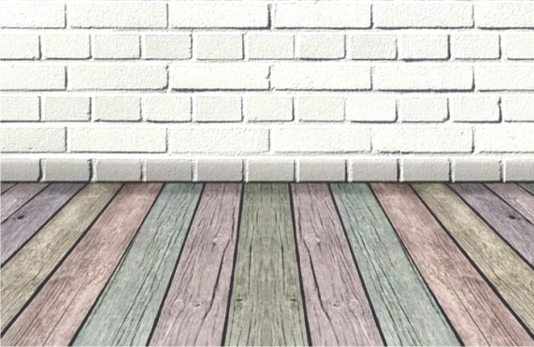
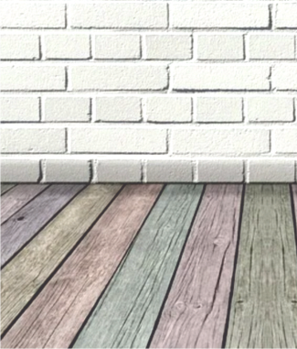
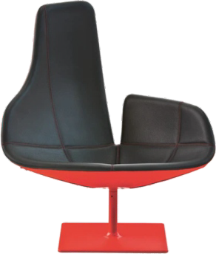
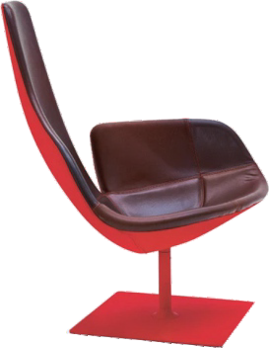
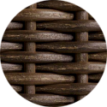
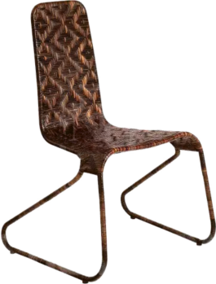
REVISION CARDS - PATRICIA URQUIOLA
WORLD ASSOCIATION OF TECHNOLOGY TEACHERS https://www.facebook.com/groups/254963448192823/
www.technologystudent.com © 2023 V.Ryan © 2023
PATRICIA URQUIOLA
Patricia Urquiola is a Spanish designer with an international reputation. She studied at the Universidad Politécnica de Madrid (Spain) and Politecnico di Milano (Italy).
In 2001 she established her own design studio, working on product design, interior design and architecture. She has an individual and experimental approach to design, using carefully chosen premium materials.
She worked closely with Vico Magistretti, in the design of the Flower Armchair in 1996 and with the De Padova Furniture Company.
FJORD ARMCHAIR RELAX
The Fjord Armchair Relax, was designed by Patricia Urquiola, for Moroso in 2002. A distinct design, with its asymmetrical back rest, in a distinguished, elegant, Scandinavian style. The design is inspired by a broken sea shell.
SEA SHELL
FLO CHAIR
The minimalist, Flo Chair, design by Patricia Urquiola for the furniture company Driade, in 2004. A steel frame with hard wearing brown wicker material. Suggests an African cultural inﬂuence. The wicker is hardwearing and helps to hold the framework in position. It is a material often used in African furniture.
USEFUL LINK SCAN HERE
USEFUL LINK CLICK HERE
Link
1. Who is Patricia Orquiola and where did she train as a Designer ?
2 marks
2. Describe her approach to design? Who did she collaborated with when designing the Flower Armchair?
4 marks
3. Name and describe one of his well-known designs.
4 marks

