Slide 1
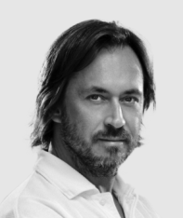
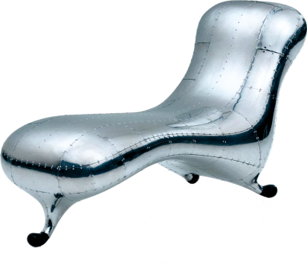
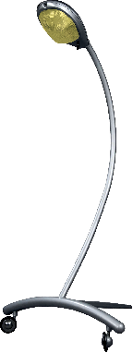
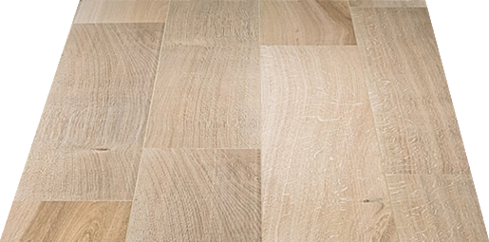
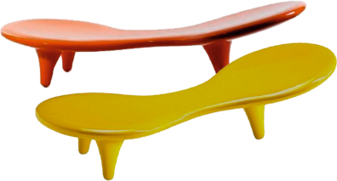
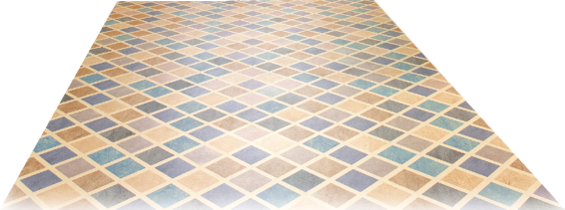
REVISION CARDS - MARC NEWSON CBE
WORLD ASSOCIATION OF TECHNOLOGY TEACHERS https://www.facebook.com/groups/254963448192823/
www.technologystudent.com © 2023 V.Ryan © 2023
MARC NEWSON
LOCKHEED LOUNGE CHAIR
He designed the ﬁrst version of the famous Lockheed Lounge Chair in 1986. This has become an iconic design, manufactured from sheet aluminium, with sections rivetted together, the same technique as aircraft wings / fuselage. The chair is often described as the most expensive lounge chair in the world, having achieved high prices at auctions.
Marc Newson designed the stylish ‘Super Guppy’ lamp in 1987, and the Orange Lounge and Table manufactured from moulded ﬁbre glass in1989, when working in Tokyo.
The Newson Aluminium Chair 2018, was inﬂuenced by the style of the Bauhaus MB 118 Chair, by Marcel Breuer. The Newson chair is a modern, stylish adaptation, of the cantilever chairs of the past.
Super Guppy and Orange Lounge / Table
USEFUL LINK SCAN HERE
USEFUL LINK CLICK HERE
Link
Marc Newson is an
internationally recognised Australian designer. He works across various disciplines, including furniture, clothing / textiles, jewellery, watches,
cookware, glass products and aerospace.
He graduated in 1984 from the Sydney College of Arts.
He has worked in several countries, for well known companies / brands, such as Nike, Qantas Airways and Apple.
He has his own Design Company. Marc Newson is regarded as one of the most inﬂuential designers of our time.
1. Who is Marc Newson and which disciplines has he worked with ? 2 marks
2. Describe the Lockheed Lounge Chair. Include the main construction technique.
4 marks
3. Name and describe one more of his well-known designs.
4 marks

