Slide 1
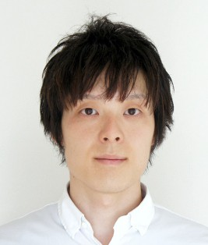
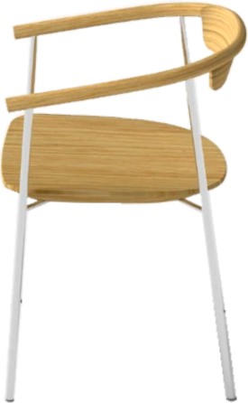
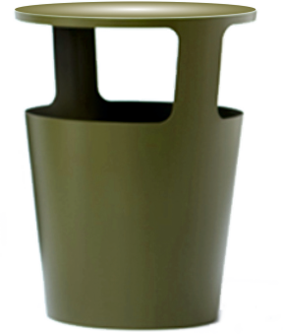
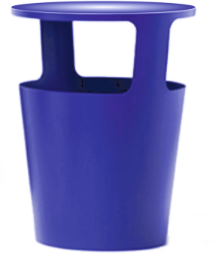
REVISION CARDS - DAISUKE KITAGAWA
WORLD ASSOCIATION OF TECHNOLOGY TEACHERS https://www.facebook.com/groups/254963448192823/
www.technologystudent.com © 2023 V.Ryan © 2023
DAISUKE KITAGAWA
Daisuke Kitagawa graduated from the Kanazawa College of Art in 2005. In 2011, he established his company ‘Daisuke Kitagawa Design’.
A year later he was named by ‘The New York Times’, as one of most prominent new designers. His background in home appliance design with NEC, He keeping to the tradition of Japanese design, characterised by simplicity, a minimalist philosophy, functionality, ingenuity and aesthetically pleasing products. His designs are both elegant and contemporary.
THE STRUT CHAIR
The Strut Chair is comfortable, stylish and minimalist. The beautifully formed natural wood and chrome steel frame, are carefully proportioned. The materials complement each other. The chair is self-assembly, ergonomically designed and understated.
‘TRIFLE’ STORAGE UNIT
The ‘Triﬂe’ storage unit is a contemporary Daisuke design, with a dual purpose. It can be a storage unit or a table. The lightweight, thin sheet steel construction, gives structural strength and is 100% recyclable.
USEFUL LINK SCAN HERE
USEFUL LINK CLICK HERE
Link
1. Who is Daisuke Kitagawa and what is his design background ?
2 marks
2. Describe the characteristics of Daisuke’s designs ?
3 marks
3. Name and describe one more of his well-known designs.
4 marks

