Slide 1
THE SALTER DUCK
WORLD ASSOCIATION OF TECHNOLOGY TEACHERS https://www.facebook.com/groups/254963448192823/ www.technologystudent.com © 2023 V.Ryan © 2023
HELPFUL LINKS: https://technologystudent.com/energy1/tidal7.htm
1. How did the gyroscopic electrical generator convert the motion of waves to electrical energy? (Include a labelled diagram / image to support your answer). 5 marks
2. Why did the UK Government think it was important to develop alternative energy in the 1970s? Why the Salter Duck not put into full scale manufacture? (Include the reasons put forward by Stephen Salter) 6 marks

Slide 2
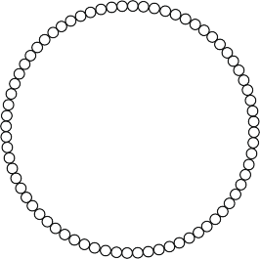
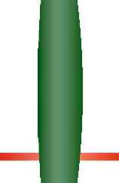
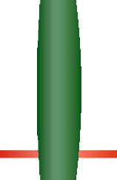
THE SALTER DUCK
WORLD ASSOCIATION OF TECHNOLOGY TEACHERS https://www.facebook.com/groups/254963448192823/
www.technologystudent.com © 2023 V.Ryan © 2023
HELPFUL LINKS: https://technologystudent.com/energy1/tidal7.htm
3. Paste an image showing the relative size of the Salter Duck. 3 marks
4. Complete the diagram of the Salter Duck’s power canister by adding identifying labels.
5 marks
V.Ryan © 2023
OFF ON
V.Ryan © 2023
V.Ryan © 2023
V.Ryan © 2023
V.Ryan © 2023
V.Ryan © 2023
1
2
3
4

