Slide 2
THIRD ANGLE ORTHOGRAPHIC DRAWING
WORLD ASSOCIATION OF TECHNOLOGY TEACHERS https://www.facebook.com/groups/254963448192823/ technologystudent.com © 2023
V.Ryan © 2023
HELPFUL LINK: https://technologystudent.com/despro_3/sectional1.html
ORTHOGRAPHIC SECTIONAL VIEW
(THIRD ANGLE PROJECTION)
COMPLETE THE THREE VIEWS OF THE SOLID OBJECT SHOWN BELOW, INCLUDING A SECTIONAL END VIEW ON ‘AA’.
HELPFUL LINK
A
A
V.Ryan © 2023
A
PLEASE ESTIMATE ALL MEASUREMENTS
BASE LINE
A
SECTIONAL END VIEW ON ‘AA’
THIRD ANGLE PROJECTION

Slide 3
THIRD ANGLE ORTHOGRAPHIC DRAWING
WORLD ASSOCIATION OF TECHNOLOGY TEACHERS https://www.facebook.com/groups/254963448192823/ technologystudent.com © 2023
V.Ryan © 2023
HELPFUL LINK: https://technologystudent.com/despro_3/sectional2.html
ORTHOGRAPHIC SECTIONAL VIEW
(THIRD ANGLE PROJECTION)
COMPLETE THE THREE VIEWS OF THE SOLID OBJECT SHOWN BELOW, INCLUDING A SECTIONAL END VIEW ON ‘AA’.
HELPFUL LINK
A
A
V.Ryan © 2023
A
PLEASE ESTIMATE ALL MEASUREMENTS
BASE LINE
A
SECTIONAL END VIEW ON ‘AA’
THIRD ANGLE PROJECTION

Slide 4
THIRD ANGLE ORTHOGRAPHIC DRAWING
WORLD ASSOCIATION OF TECHNOLOGY TEACHERS https://www.facebook.com/groups/254963448192823/
technologystudent.com © 2023 V.Ryan © 2023
COMPLETE THE THREE VIEWS OF THE SQUARE PYRAMID SHOWN OPPOSITE, INCLUDING A SECTIONAL PLAN VIEW ON ‘XX’.
HELPFUL LINK: https://technologystudent.com/despro_3/sectional3.html
THIRD ANGLE PROJECTION
SECTIONAL PLAN VIEW ON ‘XX’
SQUARE PYRAMID
HELPFUL LINK
X
X
THE BLUE LINES SHOW THE AREA THAT HAS BEEN CUT AWAY / REMOVED.
X
X
X
X
BASE LINE
FRONT VIEW
SIDE VIEW

Slide 5
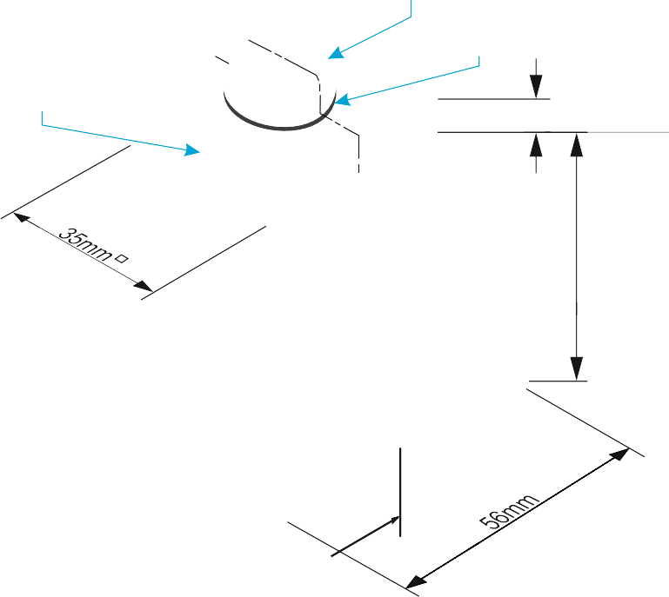
SECTIONAL VIEWS - THIRD ANGLE ORTHOGRAPHIC DRAWING
WORLD ASSOCIATION OF TECHNOLOGY TEACHERS https://www.facebook.com/groups/254963448192823/
technologystudent.com © 2023 V.Ryan © 2023
HELPFUL LINK: https://technologystudent.com/despro_3/sectional4.html
COMPLETE THE THREE VIEWS OF THE
PLAN VIEW
BLOCK AND BOLT SHOWN BELOW, INCLUDING THE SECTIONAL FRONT VIEW
ADD SIX DIMENSIONS
HELPFUL LINK
MACHINE BOLT
WASHER
A
STEEL PLATE
6
A
56mm
V.Ryan © 2022
A
BASE LINE
V.Ryan © 2023
A
THIRD ANGLE PROJECTION
SECTIONAL FRONT ELEVATION ON ‘AA’
SIDE VIEW

Slide 6
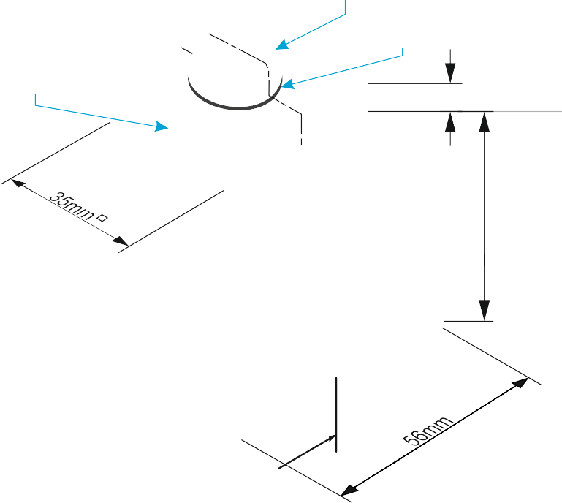
SECTIONAL VIEWS - THIRD ANGLE ORTHOGRAPHIC DRAWING
WORLD ASSOCIATION OF TECHNOLOGY TEACHERS https://www.facebook.com/groups/254963448192823/
technologystudent.com © 2023 V.Ryan © 2023
15mm
DRAW THE SECTIONAL FRONT VIEW, SIDE AND PLAN VIEWS OF THE BLOCK AND BOLT. FOLLOW THE DIMENSIONS SHOWN BELOW. WHERE NECESSARY, ESTIMATE MEASUREMENTS.
ADD SIX DIMENSIONS TO YOUR COMPLETED ORTHOGRAPHIC DRAWING
10mm 1.5mm
6
V.Ryan © 2022
10mm
8mm
MACHINE BOLT
WASHER
A
STEEL PLATE
6
56mm
BASE LINE
A
HELPFUL LINK
HELPFUL LINK: https://technologystudent.com/despro_3/sectional4.html
THIRD ANGLE PROJECTION

Slide 7
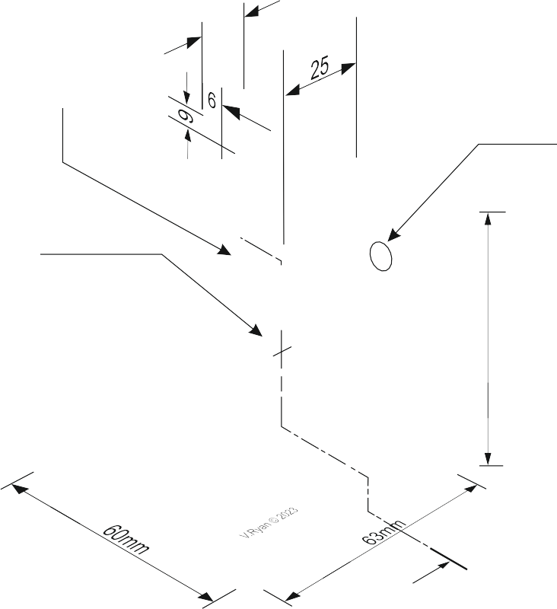
SECTIONAL VIEWS - THIRD ANGLE ORTHOGRAPHIC DRAWING
WORLD ASSOCIATION OF TECHNOLOGY TEACHERS https://www.facebook.com/groups/254963448192823/
technologystudent.com © 2023 V.Ryan © 2023
HELPFUL LINK: https://technologystudent.com/despro_3/sectional5.html
COMPLETE THE THREE VIEWS OF THE CAST ALUMINIUM BRACKET SHOWN BELOW. INCLUDING THE SECTIONAL FRONT VIEW.
PLAN VIEW
ADD SIX DIMENSIONS
HELPFUL LINK
CALLED A
WEB
R6mm
A
DIA 12mm
73mm
A
A
BASE LINE
A
THIRD ANGLE PROJECTION
SECTIONAL FRONT ELEVATION ON ‘AA’
SIDE VIEW

Slide 8
SECTIONAL VIEWS - THIRD ANGLE ORTHOGRAPHIC DRAWING
WORLD ASSOCIATION OF TECHNOLOGY TEACHERS https://www.facebook.com/groups/254963448192823/
technologystudent.com © 2023 V.Ryan © 2023
HELPFUL LINK: https://technologystudent.com/despro_3/sectional5.html
DRAW THE SECTIONAL FRONT VIEW, SIDE AND PLAN VIEWS OF THE CAST ALUMINIUM BRACKET. FOLLOW THE DIMENSIONS SHOWN BELOW. WHERE NECESSARY, ESTIMATE MEASUREMENTS.
ADD SIX DIMENSIONS TO YOUR COMPLETED ORTHOGRAPHIC DRAWING
HELPFUL LINK
CALLED A
WEB
R6mm
DIA 12mm
73mm
A
A
BASE LINE
THIRD ANGLE PROJECTION
SECTIONAL FRONT ELEVATION ON ‘AA’
SIDE VIEW

Slide 9
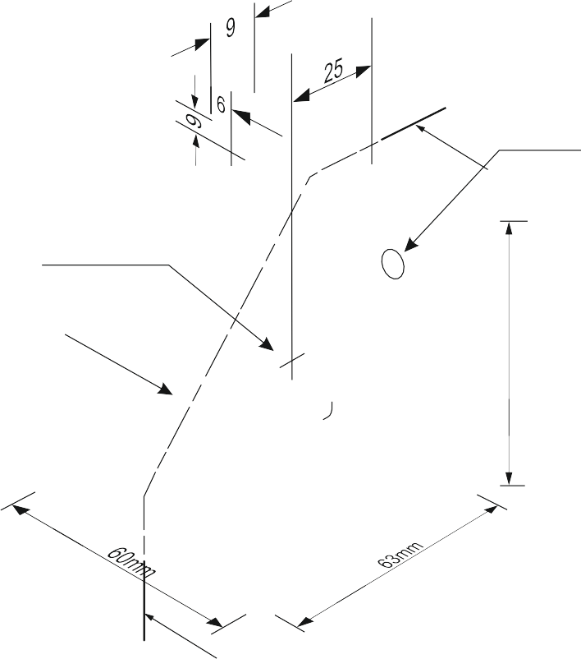
SECTIONAL VIEWS - THIRD ANGLE ORTHOGRAPHIC DRAWING
WORLD ASSOCIATION OF TECHNOLOGY TEACHERS https://www.facebook.com/groups/254963448192823/
technologystudent.com © 2023 V.Ryan © 2023
COMPLETE THE SECTIONAL SIDE VIEW AND ALSO THE FRONT VIEW OF THE CAST ALUMINIUM BRACKET.
FOLLOW THE DIMENSIONS SHOWN OPPOSITE. WHERE NECESSARY, ESTIMATE MEASUREMENTS.
R6mm
A
DIA 12mm
ADD SIX DIMENSIONS TO YOUR COMPLETED ORTHOGRAPHIC DRAWING
WEB
73mm
THIRD ANGLE PROJECTION
A
HATCHING NOT DRAWN ON A WEB, WHEN IT IS SECTIONED
ALONG IT’S LENGTH
A
HELPFUL LINK
FRONT VIEW
SECTIONAL SIDE ELEVATION ON ‘AA’
HELPFUL LINK: https://technologystudent.com/despro_3/sectional6.html
A

Slide 10
SECTIONAL VIEWS - THIRD ANGLE ORTHOGRAPHIC DRAWING
WORLD ASSOCIATION OF TECHNOLOGY TEACHERS https://www.facebook.com/groups/254963448192823/
technologystudent.com © 2023 V.Ryan © 2023
DRAW THE SECTIONAL SIDE VIEW AND ALSO THE FRONT VIEW OF THE CAST ALUMINIUM BRACKET.
FOLLOW THE DIMENSIONS SHOWN OPPOSITE. WHERE NECESSARY, ESTIMATE MEASUREMENTS.
R6mm
A
DIA 12mm
ADD SIX DIMENSIONS TO YOUR COMPLETED ORTHOGRAPHIC DRAWING
WEB
73mm
THIRD ANGLE PROJECTION
A
HATCHING NOT DRAWN ON A WEB, WHEN IT IS SECTIONED
ALONG ITS LENGTH
A
HELPFUL LINK
FRONT VIEW
SECTIONAL SIDE ELEVATION ON ‘AA’
HELPFUL LINK: https://technologystudent.com/despro_3/sectional6.html
A

