Slide 1
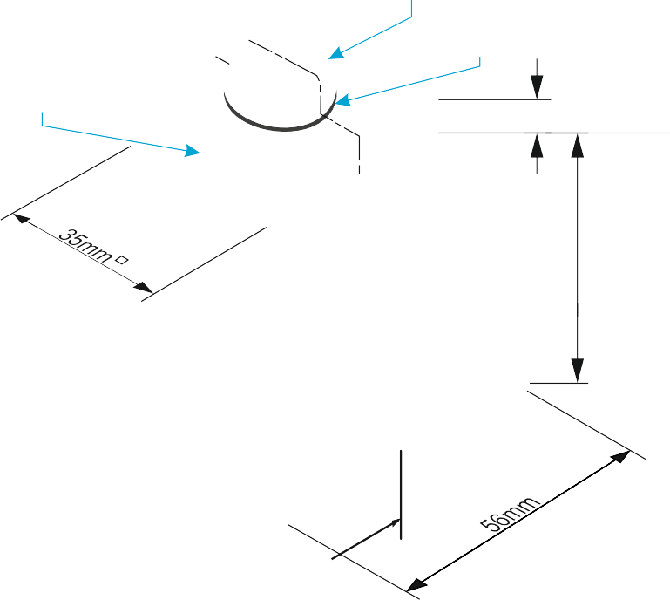
SECTIONAL VIEWS - THIRD ANGLE ORTHOGRAPHIC DRAWING
WORLD ASSOCIATION OF TECHNOLOGY TEACHERS https://www.facebook.com/groups/254963448192823/
technologystudent.com © 2023 V.Ryan © 2023
15mm
DRAW THE SECTIONAL FRONT VIEW, SIDE AND PLAN VIEWS OF THE BLOCK AND BOLT. FOLLOW THE DIMENSIONS SHOWN BELOW. WHERE NECESSARY, ESTIMATE MEASUREMENTS.
ADD SIX DIMENSIONS TO YOUR COMPLETED ORTHOGRAPHIC DRAWING
10mm 1.5mm
6
V.Ryan © 2022
10mm
8mm
MACHINE BOLT
WASHER
A
STEEL PLATE
6
56mm
BASE LINE
A
HELPFUL LINK
HELPFUL LINK: https://technologystudent.com/despro_3/sectional4.html
THIRD ANGLE PROJECTION

