Slide 1
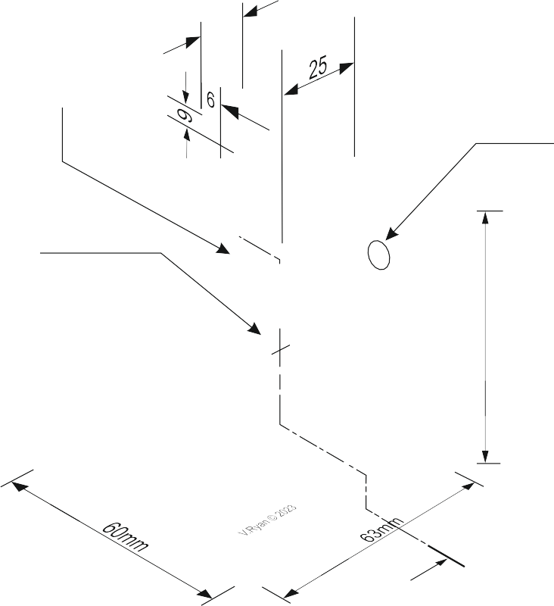
SECTIONAL VIEWS - THIRD ANGLE ORTHOGRAPHIC DRAWING
WORLD ASSOCIATION OF TECHNOLOGY TEACHERS https://www.facebook.com/groups/254963448192823/
technologystudent.com © 2023 V.Ryan © 2023
HELPFUL LINK: https://technologystudent.com/despro_3/sectional5.html
COMPLETE THE THREE VIEWS OF THE CAST ALUMINIUM BRACKET SHOWN BELOW. INCLUDING THE SECTIONAL FRONT VIEW.
PLAN VIEW
ADD SIX DIMENSIONS
HELPFUL LINK
CALLED A
WEB
R6mm
A
DIA 12mm
73mm
A
A
BASE LINE
A
THIRD ANGLE PROJECTION
SECTIONAL FRONT ELEVATION ON ‘AA’
SIDE VIEW

