Slide 1
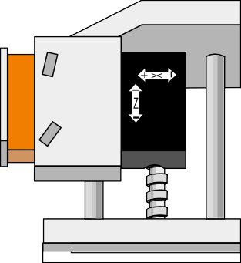
EXAMINATION QUESTIONS - CNC WORK - AN INTRODUCTION
WORLD ASSOCIATION OF TECHNOLOGY TEACHERS https://www.facebook.com/groups/254963448192823/ www.technologystudent.com © 2023 V.Ryan © 2023
HELPFUL LINKS: https://technologystudent.com/cam/cnc1.htm
1. A basic CNC machine is seen below. Add the names of the most important parts, to the drawing, in the correct place. The names are arrange blow. 8 marks
VICE
MATERIAL
CHUCK GUARD
LIGHT
LATHE BED MOTOR
CUTTING TOOL
By V.Ryan

Slide 2
EXAMINATION QUESTIONS - CNC WORK - AN INTRODUCTION
WORLD ASSOCIATION OF TECHNOLOGY TEACHERS https://www.facebook.com/groups/254963448192823/ www.technologystudent.com © 2023 V.Ryan © 2023
HELPFUL LINKS: https://technologystudent.com/cam/cnc1.htm
2. Some of the parts of the CNC machine are listed below. Write an explanation of the function of each one. 4 marks
CUTTING TOOL:
CHUCK:
GUARD:
VICE:

