Slide 1
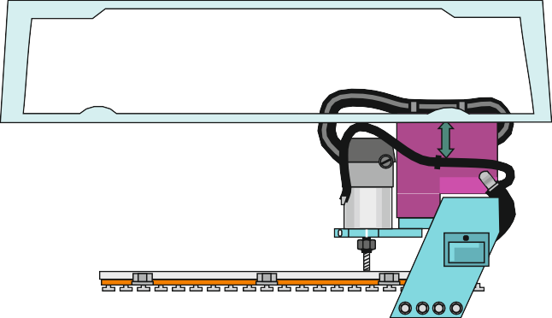
CNC MACHINES - EXAMINATION QUESTION
WORLD ASSOCIATION OF TECHNOLOGY TEACHERS https://www.facebook.com/groups/254963448192823/
www.technologystudent.com © 2020 V.Ryan © 2020
USEFUL LINKS:
https://technologystudent.com/cam/cncman1.htm https://technologystudent.com/cam/cncman4.htm
1. A typical CNC machine is seen below. Label all the parts that relate directly to safety.
6 marks
By V.Ryan
Boxford _{A3 HSR2}
3D HIGH - SPEED ROUTER
Z+
Z-
I/O
₋Z
+
X-
Y+
Y-
%
X+
POWER BREAKER
BOXFORD
2. Describe four advantages to using CNC machines compared to manually operated machines. 4 marks
A.
B.
C.
D.

Slide 2
CNC MACHINES - EXAMINATION QUESTION
WORLD ASSOCIATION OF TECHNOLOGY TEACHERS https://www.facebook.com/groups/254963448192823/
www.technologystudent.com © 2020 V.Ryan © 2020
USEFUL LINKS:
https://technologystudent.com/cam/cncman1.htm https://technologystudent.com/cam/cncman4.htm
3. Describe four disadvantages to using manual machines compared to CNC machines.
4 marks
A.
B.
C.
D.
4. What does CNC mean ? 3 marks
C=
N=
C=

