Slide 1
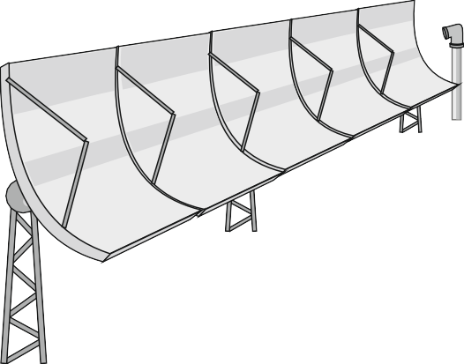
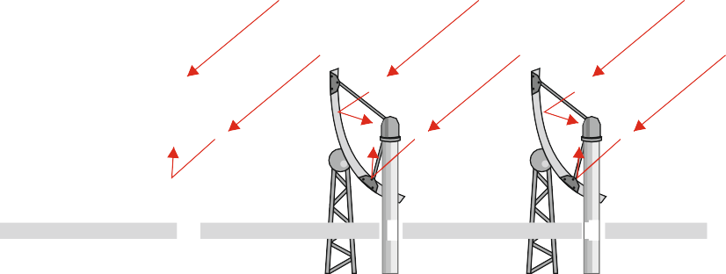
EXAMINATION QUESTIONS - PARABOLIC SOLAR COLLECTORS
WORLD ASSOCIATION OF TECHNOLOGY TEACHERS https://www.facebook.com/groups/254963448192823/ www.technologystudent.com © 2023 V.Ryan © 2023
HELPFUL LINKS: https://technologystudent.com/energy1/solar3.htm
1. A typical parabolic solar collector system, for heating fluids, is seen below. Explain how this type of system works. Add labels to the diagram if you feel this will aid your explanation. 6 marks
2. A parabolic solar collector system works in conjunction with a heat exchanger. Add a heat exchanger to the diagram below. 6 marks

Slide 2
EXAMINATION QUESTIONS - PARABOLIC SOLAR COLLECTORS
WORLD ASSOCIATION OF TECHNOLOGY TEACHERS https://www.facebook.com/groups/254963448192823/ www.technologystudent.com © 2023 V.Ryan © 2023
HELPFUL LINKS: https://technologystudent.com/energy1/solar3.htm
3. Parabolic collector systems can generate electricity. Paste an image of this type of system. Explain how the system works. 8 marks
DIAGRAM
NOTES

