Slide 1
EXAMINATION QUESTIONS - WHAT IS PHOTOVOLTAICS ?
WORLD ASSOCIATION OF TECHNOLOGY TEACHERS https://www.facebook.com/groups/254963448192823/ www.technologystudent.com © 2023 V.Ryan © 2023
HELPFUL LINKS: https://technologystudent.com/energy1/solar5.htm
1. How does photovoltaics differ from solar panels that are used to produce hot water?
2 marks
2. Photovoltaics have been applied to a range of small devices. Name, describe and explain the use of one such a device. 2 marks
2. Describe one way in which photovoltaics have been used in the third world / developing countries or in remote places. Include a labelled diagram. You may need to search the internet for examples. 4 marks
DIAGRAM
NOTES

Slide 2
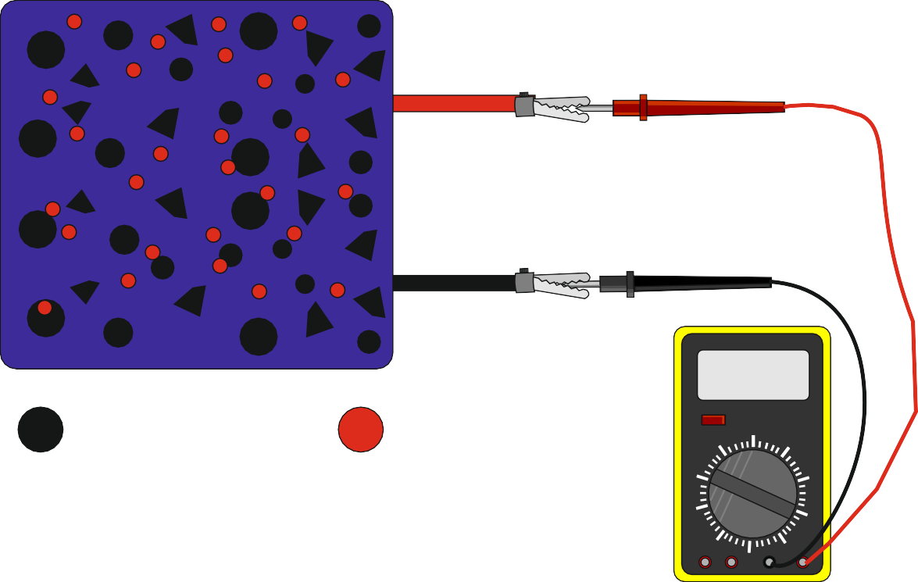
EXAMINATION QUESTIONS - WHAT IS PHOTOVOLTAICS ?
WORLD ASSOCIATION OF TECHNOLOGY TEACHERS https://www.facebook.com/groups/254963448192823/ www.technologystudent.com © 2023 V.Ryan © 2023
HELPFUL LINKS: https://technologystudent.com/energy1/solar5.htm
3. Explain how a photovoltaic cell works with reference to the diagram below. 4 marks
+
_
V.Ryan © 2005
0.06
SILICON
IMPURITIES
FREE ELECTRONS

