Slide 1
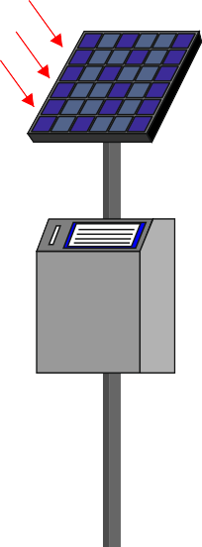
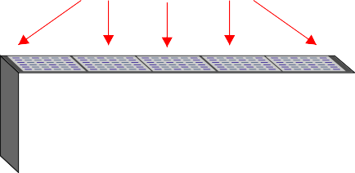
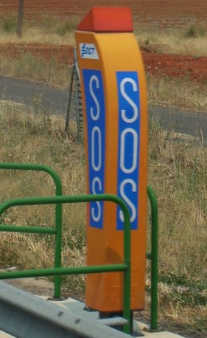
DESIGN A SOLAR POWERED DEVICE
WORLD ASSOCIATION OF TECHNOLOGY TEACHERS https://www.facebook.com/groups/254963448192823/ www.technologystudent.com © 2023 V.Ryan © 2023
HELPFUL LINKS: https://technologystudent.com/energy1/solar8.htm
The solar powered devices shown below are all connected with road safety or traffic control. The Government have asked you to design a new street lamp/light powered by solar energy. The lamp must have a sensor to detect when it is dark and when people are near it. The lamp/light must be stylish, energy efficient and interesting to look at.
SOLAR PANELS
P
SOLAR PANEL
EMERGENCY PHONE
S
O
S
FRONT VIEW
SIDE VIEW
PHOTOGRAPH SPAIN 2006

