Slide 1
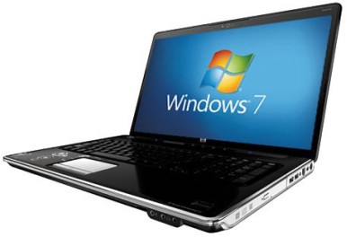
EXAMINATION QUESTIONS - VINYL CUTTERS
WORLD ASSOCIATION OF TECHNOLOGY TEACHERS https://www.facebook.com/groups/254963448192823/ www.technologystudent.com © 2023 V.Ryan © 2023
HELPFUL LINKS: https://technologystudent.com/despro2/devman1.htm
1. Describe / explain a typical use of a Vinyl Cutter. 2 marks
2. What materials can be cut on the vinyl cutter. You may wish to search the internet for suppliers of vinyl cutters and materials, to help you answer this question. 2 marks
3. Name a piece of software that controls a vinyl cutter. 2 marks
4. The computer (including software), vinyl cutter and manufactured package, can be viewed as a Systems Diagram, see below. Systems diagrams are divided into three aspects/stages - INPUT - PROCESS - OUTPUT. Complete the systems diagram below, by adding appropriate notes for each aspect/stage. The notes should describe what happens at each stage, from the design to manufacture, of a simple package. 6 marks
INPUT PROCESS OUTPUT

Slide 2
EXAMINATION QUESTIONS - VINYL CUTTERS
WORLD ASSOCIATION OF TECHNOLOGY TEACHERS https://www.facebook.com/groups/254963448192823/ www.technologystudent.com © 2023 V.Ryan © 2023
HELPFUL LINKS: https://technologystudent.com/despro2/devman1.htm
5. Vinyl cutters can be used to produce a range of manufactured products or parts of products. Describe some of these. Include a description of how these products / parts of products are used. The key words / phrases may help you answer the question. 8 marks
LETTERING PACKAGES SYMBOLS
DIRECTIONAL SIGNS
SHAPES
WARNING SIGNS
LABELS
DOOR SIGNS

