Slide 1
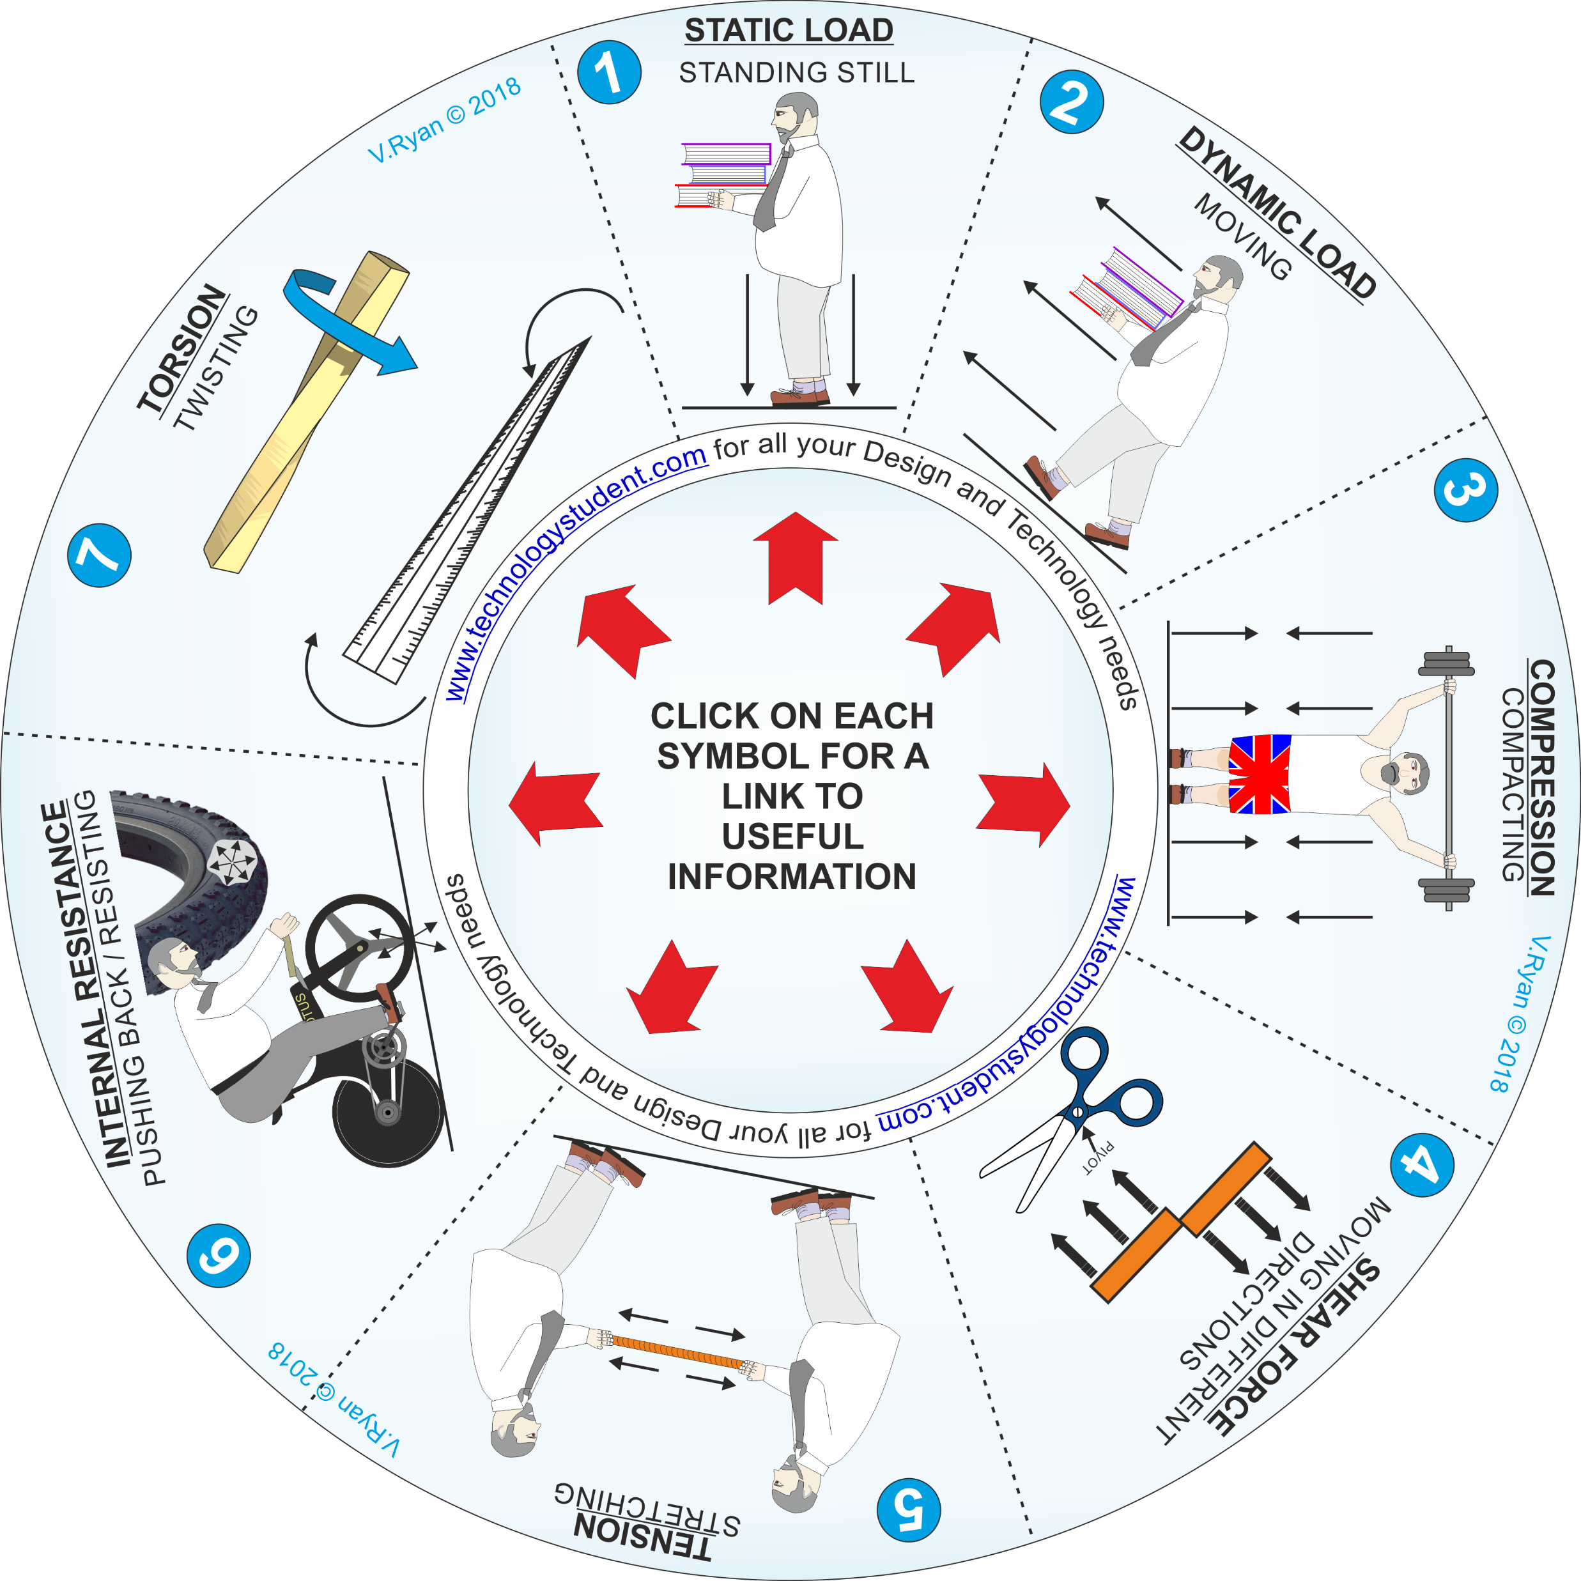
FORCES ‘LEARNING CIRCLE’
This ‘Forces Learning Circle’, includes images representing a variety of forces. Each force has been numbered.
Click on each image, for a link to useful information.
Describe each force, on the following slides. Include a practical / real life example of each force.
If you click on the circle, you will be able to rotate it, making it easier to view the images.

