Slide 1
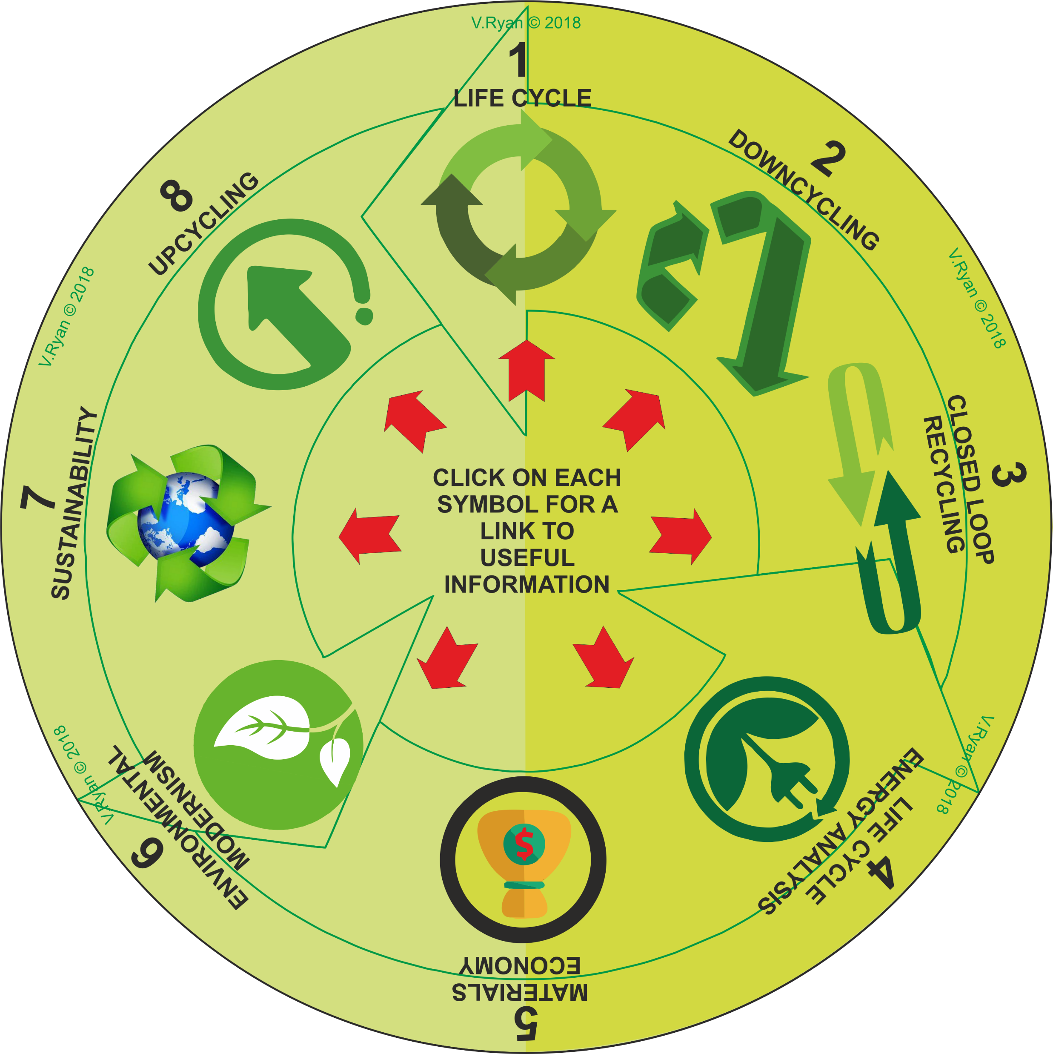
ENVIRONMENTAL ISSUES ‘LEARNING CIRCLE’
This ‘Learning Circle’, includes symbols that represent important environmental issues. Each symbol has been numbered.
Describe the meaning of each symbol / issue, on the following slides.
Click on each symbol, for a link to useful information.
If you click on the circle, you will be able to rotate it, making it easier to read the symbols.

