Slide 1
DESIGN AND TECHNOLOGY
NAME: FORM/GROUP:
REVISION BOOKLET
https://www.fa4cebook.com/groups/254963448192823/
WORLD ASSOCIATION OF TECHNOLOGY TEACHERS
www.technologystudent.com © 2017 V.Ryan © 2017
COMPOSITE MATERIALS - FIRST BOOKLET
NATURAL WOOD CONCRETE
STEEL REINFORCED CONCRETE FIBREGLASS / GLASS REINFORCE PLASTIC (GRP)
CARBON FIBRE REINFORCED POLYMER (CFRP)
WORLD ASSOCIATION OF TECHNOLOGY TEACHERS https://www.facebook.com/groups/254963448192823/
www.technologystudent.com © 2017 V.Ryan © 2017
SUITABLE REVISION MATERIAL FOR:
PRODUCT DESIGN RESISTANT MATERIALS GRAPHIC PRODUCTS DESIGN AND TECHNOLOGY
This examination booklet can be duplicated and printed out if required but not edited in any way.
The links to www.technologystudent.com cannot be removed.
The PDF ﬁle can be stored on school / college systems and distributed electronically (NO EDITING ALLOWED)
PLEASE RESPECT THE COPYRIGHT - report infringers to techteacher@technologystudent.com Not be distributed at courses or by course instructors / consultants
WORLD ASSOCIATION OF TECHNOLOGY TEACHERS https://www.facebook.com/groups/254963448192823/
www.technologystudent.com © 2017 V.Ryan © 2017

Slide 2
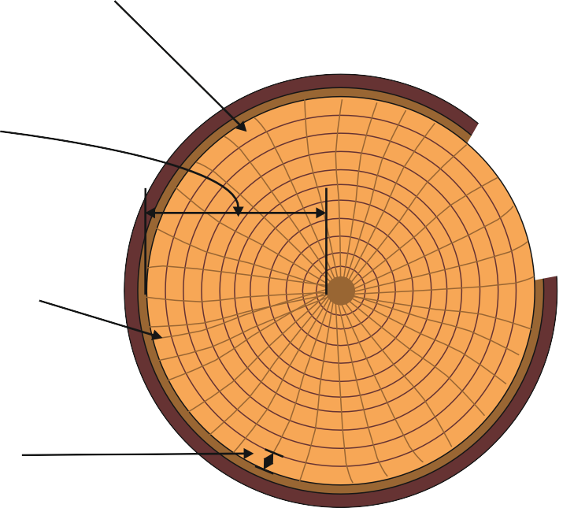
COMPOSITE MATERIALS - NATURAL WOODS
WORLD ASSOCIATION OF TECHNOLOGY TEACHERS https://www.facebook.com/groups/254963448192823/
www.technologystudent.com © 2017 V.Ryan © 2017
LINK TO HELP AND INFORMATION https://www.technologystudent.com/joints/composit1.html
1a. What is a composite material? 3 marks
1b. Why can a natural wood be considered a composite material?
3 marks
1c. Label the drawing of a cross-section of a tree trunk, naming all the parts, as indicated by the arrows. 4 marks

Slide 3
COMPOSITE MATERIALS - NATURAL WOODS - CONTINUED
WORLD ASSOCIATION OF TECHNOLOGY TEACHERS https://www.facebook.com/groups/254963448192823/
www.technologystudent.com © 2017 V.Ryan © 2017
LINK TO HELP AND INFORMATION https://www.technologystudent.com/joints/composit1.html
1d. Write a description of each of the parts of a tree trunk, listed below.
5 marks
PITH:
ANNUAL RINGS:
HEART WOOD:
SAPWOOD:
RAYS:

Slide 4
COMPOSITE MATERIALS - CONCRETE
WORLD ASSOCIATION OF TECHNOLOGY TEACHERS https://www.facebook.com/groups/254963448192823/
www.technologystudent.com © 2017 V.Ryan © 2017
LINK TO HELP AND INFORMATION https://www.technologystudent.com/joints/concret1.html
2a. Describe typical practical applications of concrete, around the home and in industry.
3 marks
2b. List the individual materials that are mixed to form concrete. 4 marks
2c. Name a precast concrete product. This could be a product bought at a typical DIY store. 1 mark
2d. In the space below, draw a diagram that clearly shows the structure of concrete. Label the component materials that form this composite material. 4 marks

Slide 5
COMPOSITE MATERIALS - CONCRETE
WORLD ASSOCIATION OF TECHNOLOGY TEACHERS https://www.facebook.com/groups/254963448192823/
www.technologystudent.com © 2017 V.Ryan © 2017
LINK TO HELP AND INFORMATION https://www.technologystudent.com/joints/concret1.html
2e. Using the internet or other research resources, collect images of practical applications of concrete. Glue samples in the space below. Label each image. 4 marks
LINK TO HELP AND INFORMATION
https://www.technologystudent.com/joints/reinforc1.html
COMPOSITE MATERIALS - STEEL REINFORCED CONCRETE
2f. Describe how the component materials that form reinforced concrete are put together. Use a diagram(s) including labels and notes. Add colour and shade to the diagram(s).
5 marks
NOTES:

Slide 6
COMPOSITE MATERIALS - STEEL REINFORCED CONCRETE
WORLD ASSOCIATION OF TECHNOLOGY TEACHERS https://www.facebook.com/groups/254963448192823/
www.technologystudent.com © 2017 V.Ryan © 2017
LINK TO HELP AND INFORMATION https://www.technologystudent.com/joints/reinforc1.html
2g. The incomplete diagram opposite, shows a cavity brick wall, supported by concrete foundations.
Complete the diagram by adding:
Arrows that indicate the direction of forces applied to the foundations. 2 marks
Additional labels. 2 marks
Notes the explain the forces applied to the cavity wall and foundations. 3 marks
CAVITY WALL
CONCRETE
2h. Draw a diagram that demonstrates the weakness of concrete, when under a tensile force. Add explanatory notes.

Slide 7
FIBREGLASS / GLASS REINFORCE PLASTIC (GRP)
WORLD ASSOCIATION OF TECHNOLOGY TEACHERS https://www.facebook.com/groups/254963448192823/
www.technologystudent.com © 2017 V.Ryan © 2017
LINK TO HELP AND INFORMATION
https://www.technologystudent.com/joints/ﬁbre1.html
3a. When was Glass Reinforced Fibre invented and by whom? 2 marks
DATE: NAME:
3b. Describe the structure of a typical piece Glass Reinforced Fibre. Include a sketch of a ‘weave’ of Glass Fibre textile. (Description - 2 marks Sketch - 2 marks)
DESCRIPTION:
SKETCH OF WEAVE

Slide 8
FIBREGLASS / GLASS REINFORCE PLASTIC (GRP)
WORLD ASSOCIATION OF TECHNOLOGY TEACHERS https://www.facebook.com/groups/254963448192823/
www.technologystudent.com © 2017 V.Ryan © 2017
LINK TO HELP AND INFORMATION
https://www.technologystudent.com/joints/ﬁbre1.html
3c. Describe some of the properties and practical applications of GRP. Use the internet as a research tool to help you answer this question, attaching a selection of images of practical uses to this page.
PROPERTIES: 3 marks
PRACTICAL APPLICATIONS: 5 marks

Slide 9
CARBON FIBRE REINFORCED POLYMER (CFRP)
WORLD ASSOCIATION OF TECHNOLOGY TEACHERS https://www.facebook.com/groups/254963448192823/
www.technologystudent.com © 2017 V.Ryan © 2017
LINK TO HELP AND INFORMATION https://www.technologystudent.com/joints/carﬁb1.html
4a. What is Carbon Fibre Reinforced Polymer? 3 marks
4b. Describe two advantages Carbon Fibre Reinforced Polymer has over materials such as GRP and Titanium? 2 marks
4c. Describe a disadvantage of CFRP compared to GRP. 2 marks
4d. Describe a practical application of CFRP in the aerospace industry. Include an explanation of why CFRP has been used.

