Slide 1
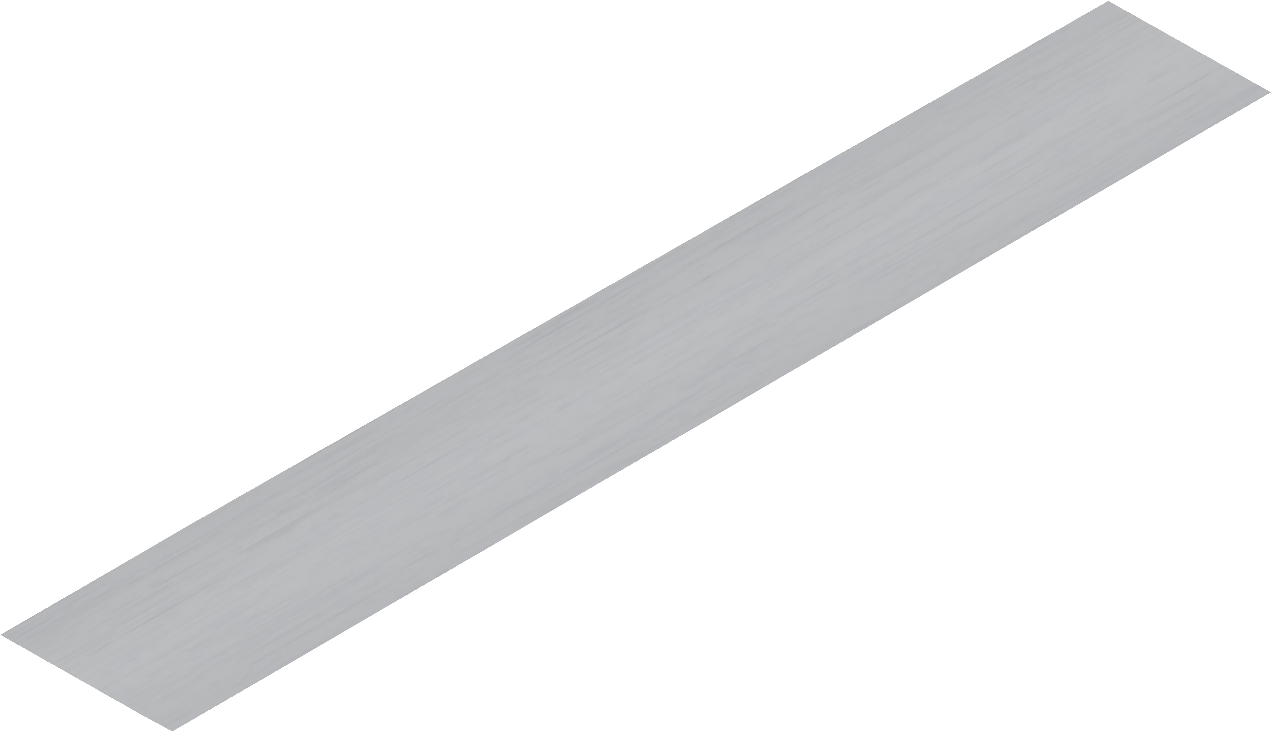
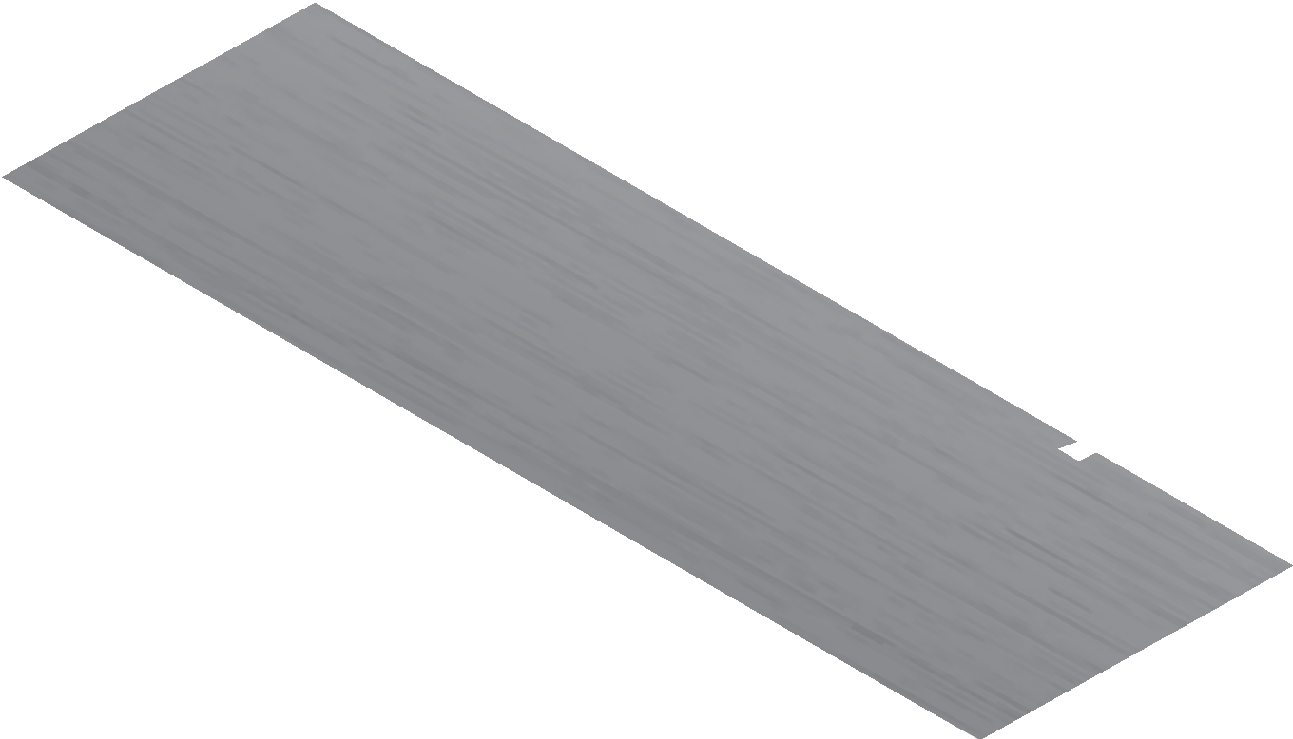
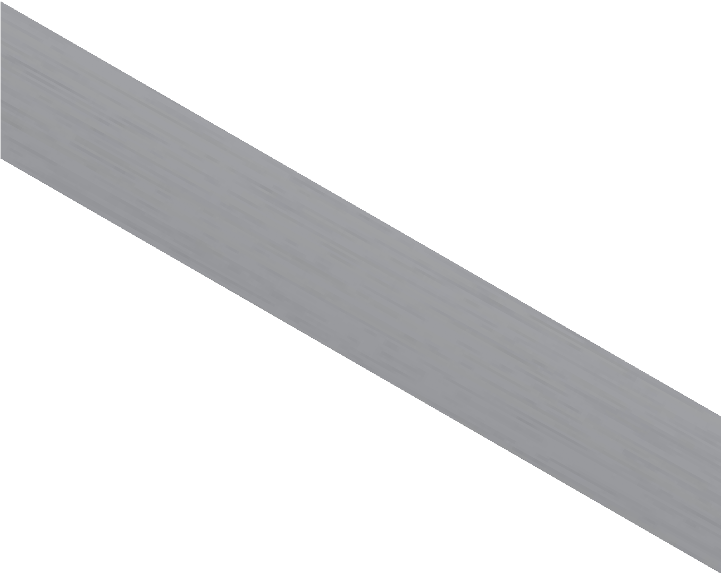
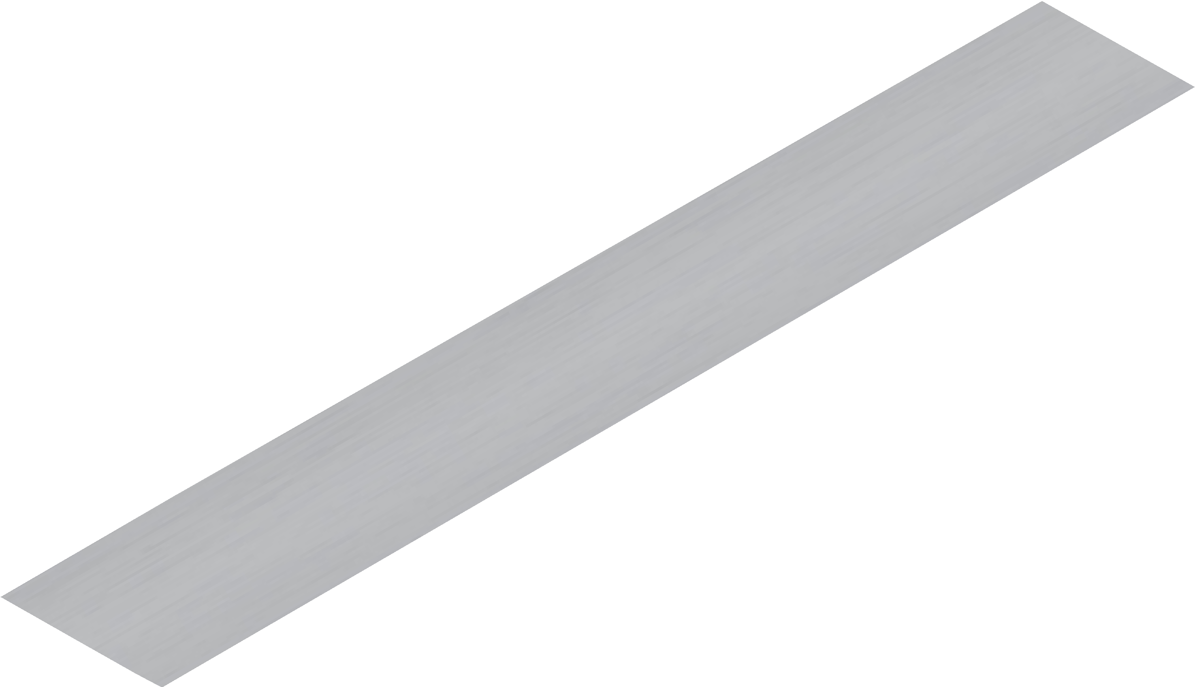
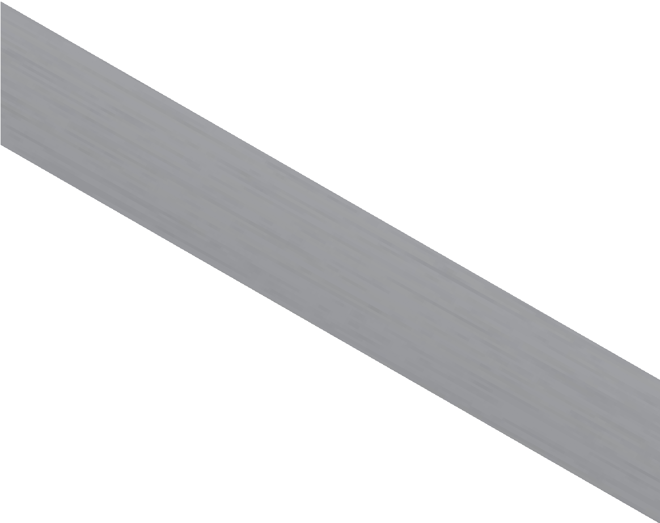
THE ENGINEERS TRY-SQUARE
V.Ryan © 2009-2023 World Association of Technology Teachers
USEFUL LINK: https://technologystudent.com/equip1/try2.htm
1. A typical engineers try square is shown opposite. How does it differ from a typical woodworkers try square? 2 marks
STOCK
BLADE
SLOT
2. What material is used to manufacture an engineers try square? 1 mark
3. The blade is specially treaded. What is this treatment called? 1 mark
4. Why is the blade treated in this special way? 1 mark
5. A try square and another engineers tool are used to mark out metals.
Label this second tool (shown on the diagram). Describe the marking out procedure. 3 marks
ENGINEERS TRY SQUARE

Slide 2
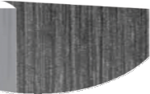
THE ENGINEERS TRY-SQUARE
V.Ryan © 2009-2023 World Association of Technology Teachers
USEFUL LINK: https://technologystudent.com/equip1/try2.htm
6. An engineers try square has been designed to include a small slot, as indicated on the diagram shown opposite. Why is this slot essential? 2 marks
V.Ryan © 2023
Ryanmatic
Made in Keighley
BURR CAUSED BY FILING
TRY-SQUARE
STEEL
7. Describe another typical use of an engineers try square. Include a sketch. 4 marks

