Slide 1
THE WOODWORKER’S BRADAWL - EXAMINATION QUESTIONS
WORLD ASSOCIATION OF TECHNOLOGY TEACHERS https://www.facebook.com/groups/254963448192823/ www.technologystudent.com © 2023 V.Ryan © 2023
HELPFUL LINK: https://www.technologystudent.com/equip_ﬂsh/bradawl1.html
1. What is a ‘woodworker’s bradawl’? Include an image. 3 marks
2. Explain one use of a bradawl. Include a sketch to support your answer. 6 marks
NOTES
SKETCH

Slide 2
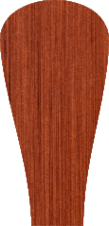
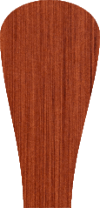
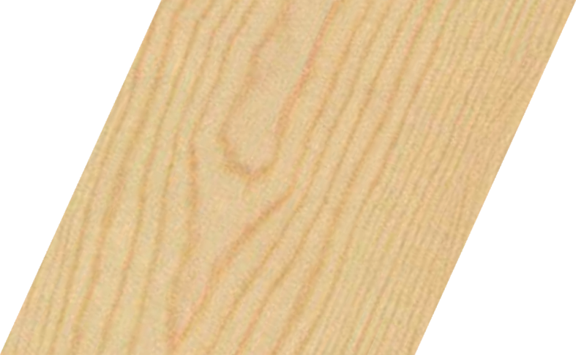
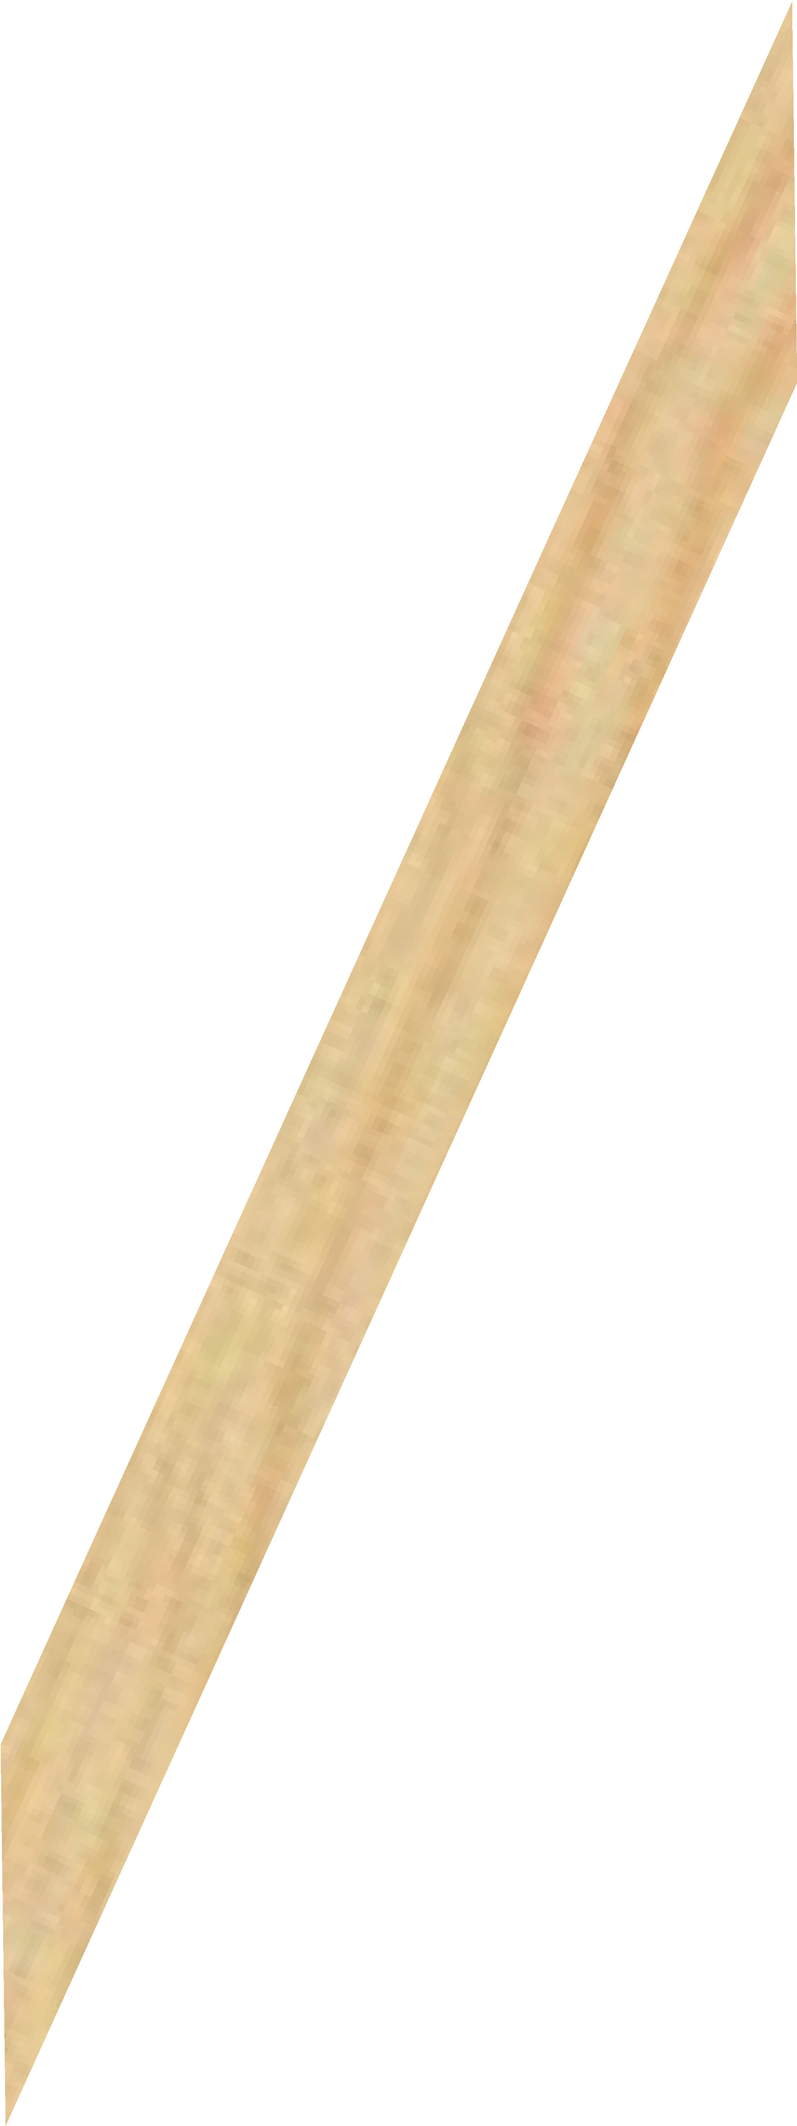
THE WOODWORKER’S BRADAWL - EXAMINATION QUESTIONS
WORLD ASSOCIATION OF TECHNOLOGY TEACHERS https://www.facebook.com/groups/254963448192823/ www.technologystudent.com © 2023 V.Ryan © 2023
HELPFUL LINK: https://www.technologystudent.com/equip_ﬂsh/bradawl1.html
3. Study the diagram below. Explain what is shown by ‘A’ and ‘B’. 4 marks
A:
B:
A
B
V.Ryan © 2023

