Slide 1
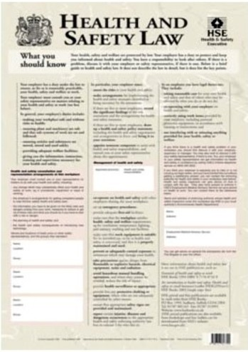
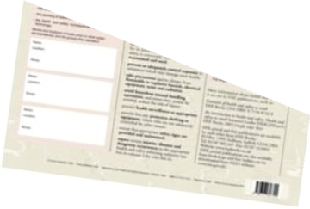
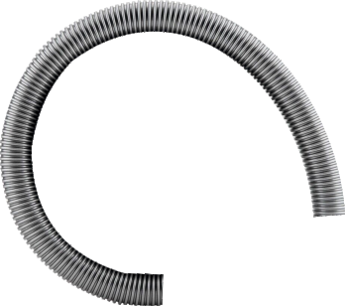
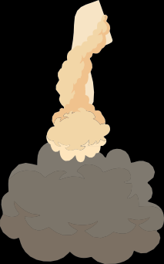
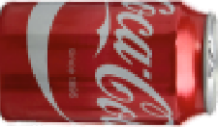
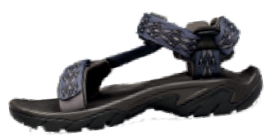
THE TABLE CIRCULAR SAW - BASIC SAFETY TEST
THE CIRCULAR SAW - BASIC SAFETY TEST
WORLD ASSOCIATION OF TECHNOLOGY TEACHERS https://www.facebook.com/groups/254963448192823/ www.technologystudent.com © 2023 V.Ryan © 2023
WORLD ASSOCIATION OF TECHNOLOGY TEACHERS https://www.facebook.com/groups/254963448192823/
www.technologystudent.com © 2023 V.Ryan © 2023
IDENTIFY WITH AN ARROW, ALL THE SAFETY ISSUES SEEN BELOW. ADD A BRIEF EXPLANATION OF
EACH ISSUE. (Click here for helpful information)
RYANMATIC
Keighley, West Yorkshire
V.Ryan © 2023
EXTRACTION
V.Ryan © 2023
WORLD ASSOCIATION OF TECHNOLOGY TEACHERS
https://www.facebook.com/groups/254963448192823/
www.technologystudent.com © 2023 V.Ryan © 2023

