Slide 1
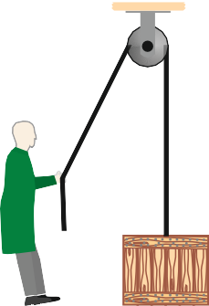
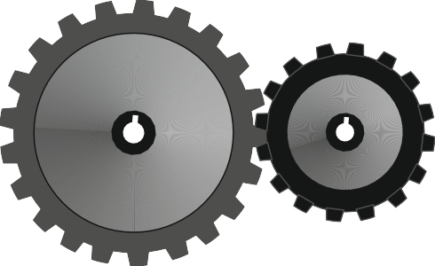
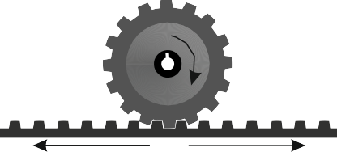
MECHANISMS STARTER
WORLD ASSOCIATION OF TECHNOLOGY TEACHERS https://www.facebook.com/groups/254963448192823/
www.technologystudent.com © 2024 V.Ryan © 2024
HELPFUL LINK: https://technologystudent.com/cams/camdex.htm
A number of mechanisms are drawn below. Write the correct name beneath each one.
SPUR GEARS SCREW THREAD CHAIN AND SPROCKET SYSTEM
LINKAGES DROP CAM
PULLEY SYSTEM RACK AND PINION
LEVERS SPRING
LOAD
EFFORT
1
TON
V.Ryan © 2023
FRAGILE
V.Ryan © 2022
Draw one more mechanism in the space opposite, Write the name of the mechanism alongside.

