Slide 1
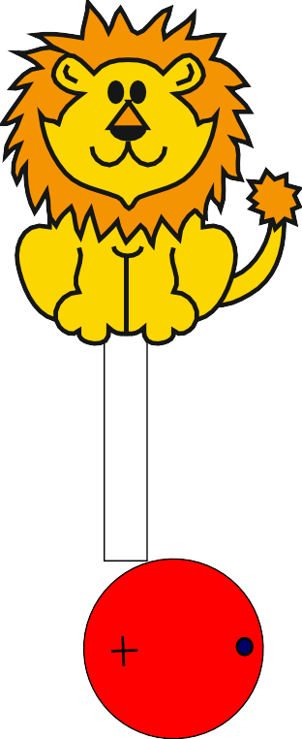
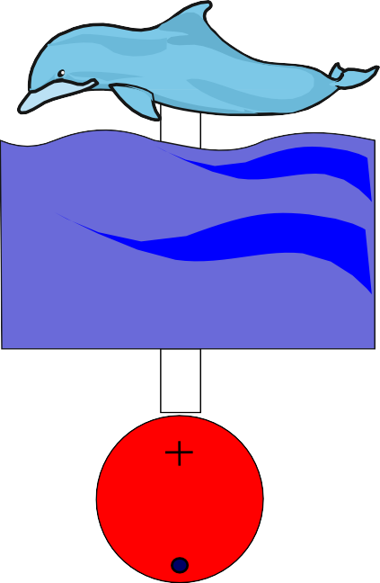
CAM TOY - RESEARCH SHEET
Below are ﬁve examples of CAM toys. They rely on an ‘eccentric’ cam, a simple follower and a slide. You will be designing and making a similar device/toy.
Before you start designing your idea, study the examples below. Follow the link to see the ideas as animations.
Select the ONE and describe how you think it works and especially how it can be improved.
HELPFUL LINK: https://technologystudent.com/cams/cam5.htm
IDEA 1
IDEA 2
IDEA 3 IDEA 4
IDEA 5
I WOZ
ERE
IDEA NUMBER:
HOW IT WORKS:
IMPROVEMENTS:
WORLD ASSOCIATION OF TECHNOLOGY TEACHERS
https://www.facebook.com/groups/254963448192823/
www.technologystudent.com © 2024 V.Ryan © 2024

