Slide 1
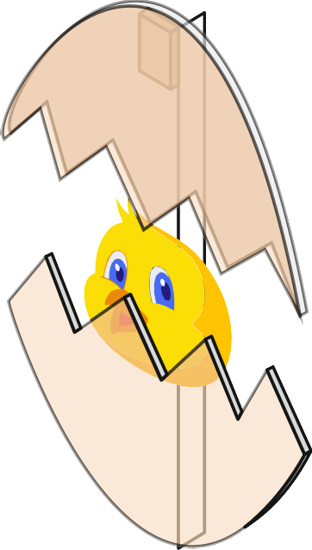
EVALUATION
WORLD ASSOCIATION OF TECHNOLOGY TEACHERS https://www.facebook.com/groups/254963448192823/
www.technologystudent.com © 2024 V.Ryan © 2024
PHOTOGRAPH(S)
HELPFUL LINKS: https://technologystudent.com/cams/mechev3.htm https://technologystudent.com/despro_ﬂsh/evalintegr1.html
ACCURACY:
My final mechanical toy is accurately made. It works without sticking.
When the handle is turned the cam rotates smoothly.
TIMESCALE:
I managed to make the toy in five lessons. This is equal to
five hours. This was just about enough time.
AESTHETICS:
COLOUR SCHEME:
I quite like the way the toy looks, especially when it is moving. However,
next time I will ensure that the top egg shell completely covers the face.
I am happy with the colours, although next time I will use brighter, more
vivid colours, as these may be more interesting to young children.
FUNCTION:
The mechanical toy works and when I tried it out on my younger brother
he liked the movement. However, he lost interest after ten minutes.
QUALITY:
The overall quality of the toy is good. The edges are smooth, the
mechanism works. However, I will use paints rather than ink - next time.
FURTHER EVALUATION POINTS
If I make the project again, I will carry out more market research.
This will help me establish accurately, what young children are attracted
to. This will mean that they are more likely to be interested in the toy for a longer
period of time. I will aim for a toy that is more complex with more movement.

Slide 2
EVALUATION
WORLD ASSOCIATION OF TECHNOLOGY TEACHERS https://www.facebook.com/groups/254963448192823/
www.technologystudent.com © 2024
V.Ryan © 2024
PHOTOGRAPH(S)
HELPFUL LINKS: https://technologystudent.com/cams/mechev3.htm https://technologystudent.com/despro_ﬂsh/evalintegr1.html
ACCURACY:
TIMESCALE:
AESTHETICS:
COLOUR SCHEME:
FUNCTION:
QUALITY:
FURTHER EVALUATION POINTS

