Slide 1
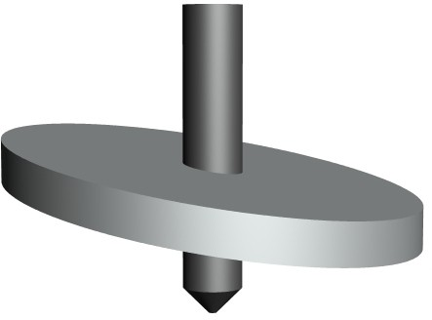
SWASH PLATE CAMS
HELPFUL LINK: https://technologystudent.com/cams/swash1.htm
1. Sketch a Swash Cam and follower. Explain how they work. 6 marks
2. A swash plate cam usually has a ‘roller’ follower. What would happen if a flat follower was used? 3 marks
3a. Label the parts of the mechanical toy, identiﬁed by arrows. 6 marks
3b. Why is a pulley system used, as part of the ‘drive’.
2 marks
D&T DEPARTMENT
V.Ryan © 2024

