Slide 1
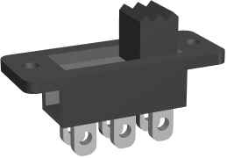
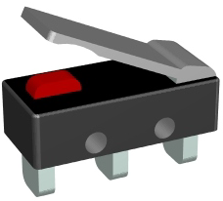
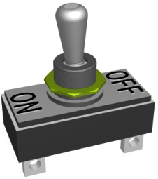
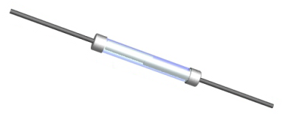
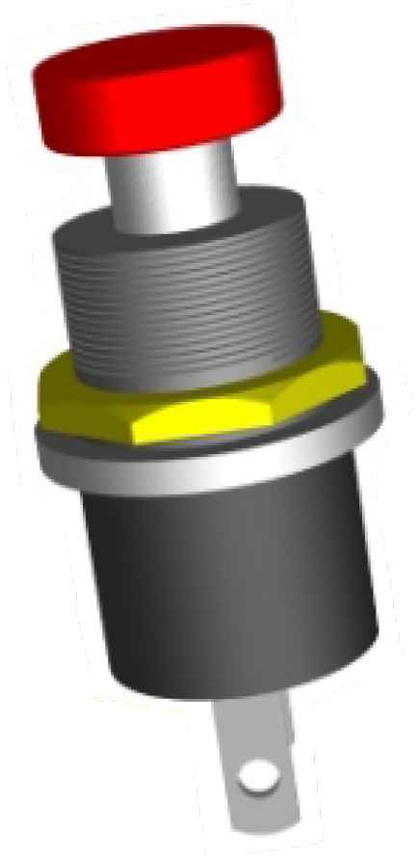
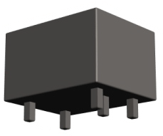
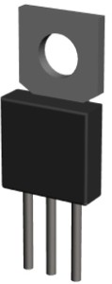
ELECTRONIC COMPONENTS AND SYMBOLS
_{HELPFUL} https://technologystudent.com/elec1/compn1.htm
Many of the components used in
LINKS:
https://technologystudent.com/elec1/compn2.htm https://technologystudent.com/elec1/compn3.htm
electronics are shown below. Either - name the component or draw its symbol / symbols.
SLIDE SWITCH
V.Ryan © 2009-2022 World Association of Technology Teachers
PUSH SWITCH
RELAY
A
G
C

Slide 2
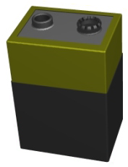
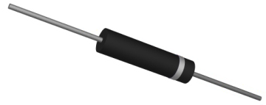
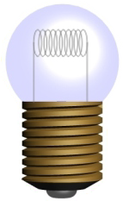
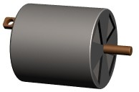
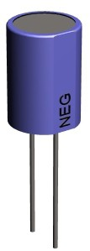
V.Ryan © 2009-2022 World Association of Technology Teachers
BATTERY / POWER RAILS |  | CELLS | POWER RAI
 | +
DIODE
MOTOR
LECTROLYTIC CAPACITOR
LS
E

Slide 3
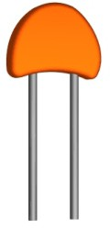
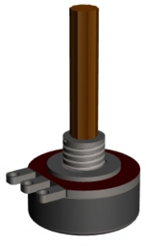
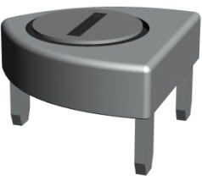
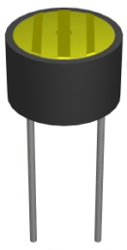
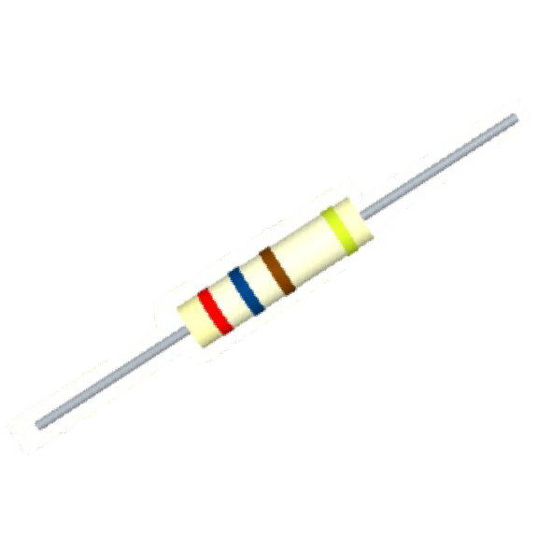
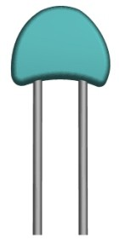
V.Ryan © 2009-2022 World Association of Technology Teachers
NON-ELECTROLYTIC CAPACITOR
PRESET RESISTOR
LDR /
LIGHT DEPENDENT RESISTOR
RESISTOR

Slide 4
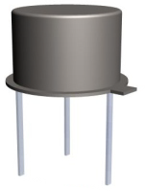
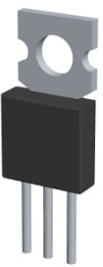
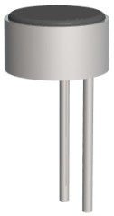
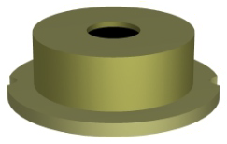
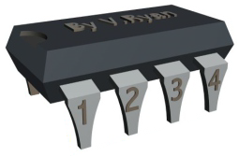
V.Ryan © 2009-2022 World Association of Technology Teachers
NPN TRANSISTOR
MICROPHONE
BUZZER
IC INTEGRATED CIRCUIT

