Slide 1
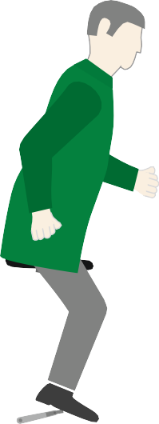
FORCES
WORLD ASSOCIATION OF TECHNOLOGY TEACHERS https://www.facebook.com/groups/254963448192823/ www.technologystudent.com © 2023 V.Ryan © 2023
HELPFUL LINKS: https://technologystudent.com/forcmom/force1.htm
Diagrams representing a range of different types of forces are shown below. Alongside each force, write a description / explanation and draw an alternative diagram.
6 marks for each force
STATIC LOAD
V.Ryan © 2023
DYNAMIC LOAD
V.Ryan © 2023
INTERNAL RESISTANCE
V.Ryan © 2023

Slide 2
FORCES
https://www.facebook.com/groups/254963448192823/ www.technologystudent.com © 2023 V.Ryan © 2023
WORLD ASSOCIATION OF TECHNOLOGY TEACHERS
HELPFUL LINKS: https://technologystudent.com/forcmom/force1.htm
TENSION
V.Ryan © 2023
COMPRESSION
D&T DEPARTMENT
V.Ryan © 2023
PIVOT
SHEAR FORCE
POINT (SHEAR FORCE)
RYANMATIC
Made in keighley

Slide 3
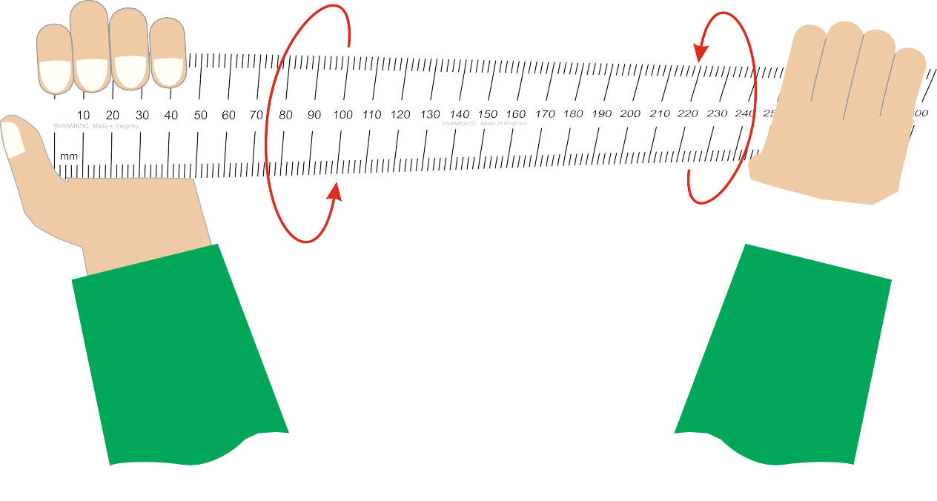
FORCES
https://www.facebook.com/groups/254963448192823/ www.technologystudent.com © 2023 V.Ryan © 2023
WORLD ASSOCIATION OF TECHNOLOGY TEACHERS
HELPFUL LINKS: https://technologystudent.com/forcmom/force1.htm
TORSION

